Slide 1
2026 ALARA+ Toolkit: ERPD Summary
Arnold Seto, MD, FSCAI, Islam Abudayyeh, MD, FSCAI, Allison Dupont, MD, FSCAI, Giorgio Medranda, MD, FSCAI, Faisal Latif, MD, FSCAI

Slide 2
Enhanced Radiation Protection: Shielding

Slide 3
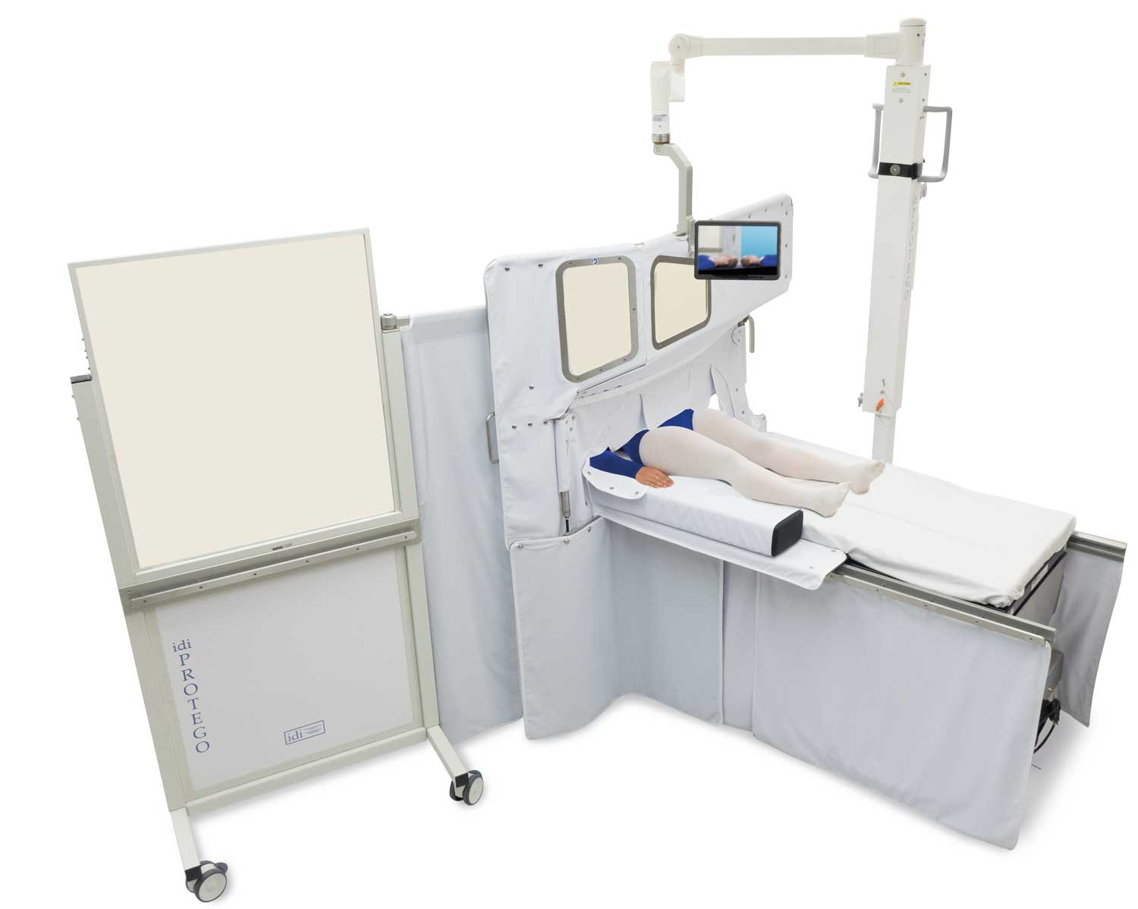
Protego
Ceiling- or mobile-pedestal-mounted modular lead “wall” between X-ray source, patient, and operator
Blocks primary beam and patient scatter
≥ 0.5 mm Pb equivalent
No lead apron required
  State of Michigan
  Andrew Goldsweig, MD, FSCAI, Lead-Free Radiation Protection, SCAI Scientific Sessions, May 2024.
Notes:
Dixon Cardiovasc Revasc Med 2022

Slide 4
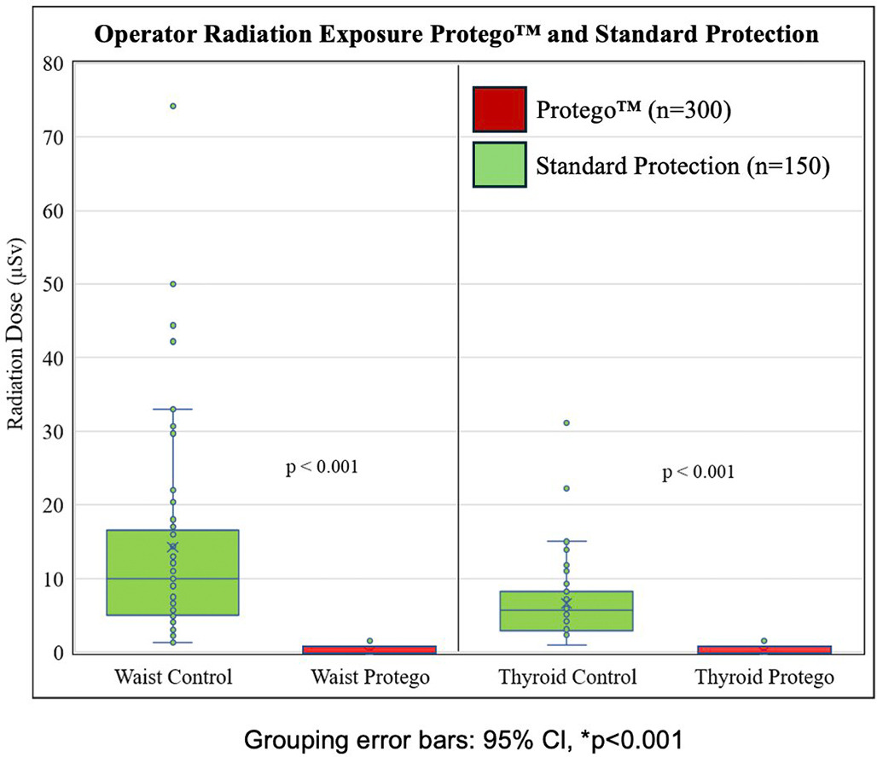
Protego
Randomized Protego (n=300) vs. lead apron (n=150) for PCI & TAVR
TLD badges outside of lead at waist/thyroid
Protego had >99% dose reduction
Median (IQR) exposure:
  Waist: 0.00 (0, 0) 𝛍Sv
  Thyroid: 0.00 (0, 0) 𝛍Sv
Andrew Goldsweig, MD, FSCAI, Lead-Free Radiation Protection, SCAI Scientific Sessions, May 2024.
Notes:
Rizik. Cardiovasc Revasc Med 2024

Slide 5
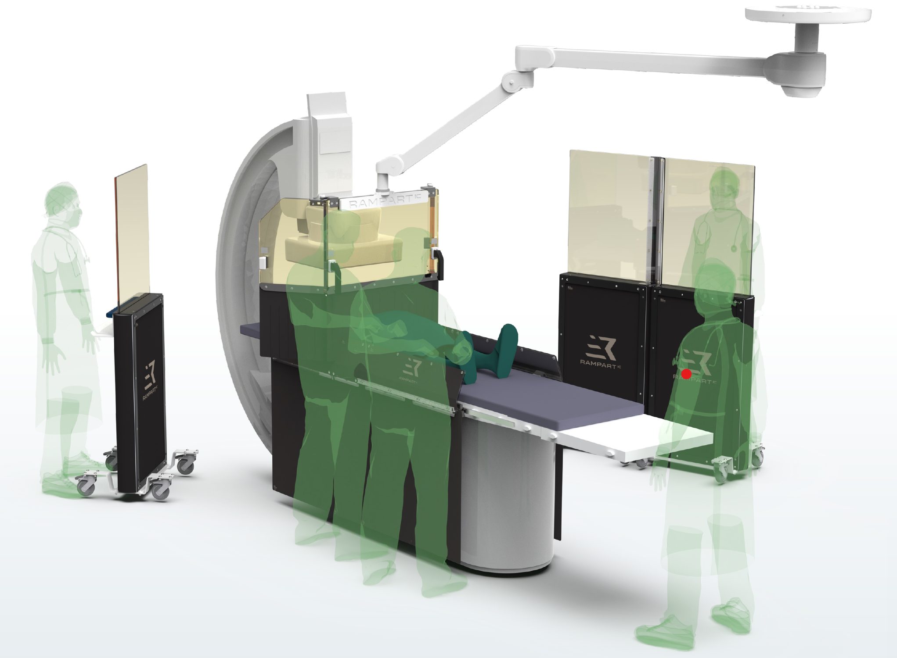
Rampart
Portable lead “wall” between X-ray source/patient and operator
1.0 mm Pb equivalent
Used in conjunction with table-mounted shields
Andrew Goldsweig, MD, FSCAI, Lead-Free Radiation Protection, SCAI Scientific Sessions, May 2024.
Notes:
works in conjunction with table-mounted shields and replaces the need for a ceiling-suspended shield

Slide 6
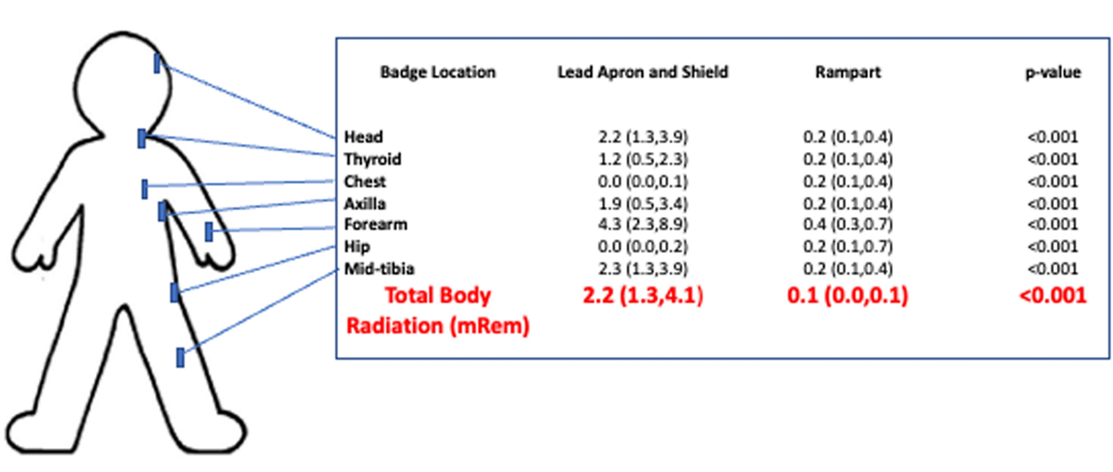
Rampart
Randomized Rampart (n=50) vs. lead apron (n=50) for coronary & SHD procedures
TLD badges outside of lead
Rampart had 97% dose reduction
Compared to NRC annual maximum of 5000 mRem
Andrew Goldsweig, MD, FSCAI, Lead-Free Radiation Protection, SCAI Scientific Sessions, May 2024.

Slide 7
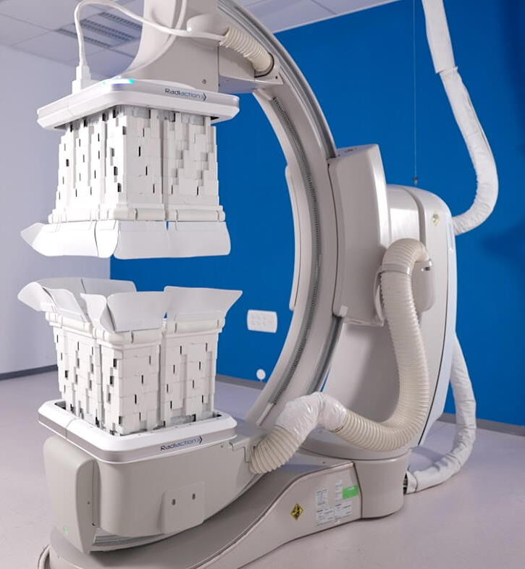
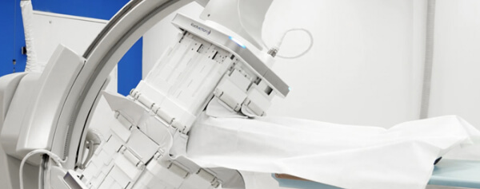
Radiaction
Sensor-driven, telescopically-retracting, C-arm-mounted shielding
Used in conjunction with table-mounted shields
Andrew Goldsweig, MD, FSCAI, Lead-Free Radiation Protection, SCAI Scientific Sessions, May 2024.

Slide 8
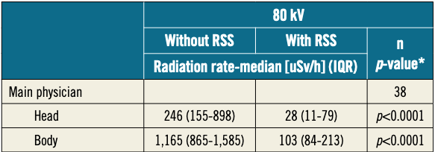
Radiaction
91.5% radiation reduction in bench testing w/ phantom
91.2% radiation reduction in 2 PCI procedures
Andrew Goldsweig, MD, FSCAI, Lead-Free Radiation Protection, SCAI Scientific Sessions, May 2024.

Slide 9
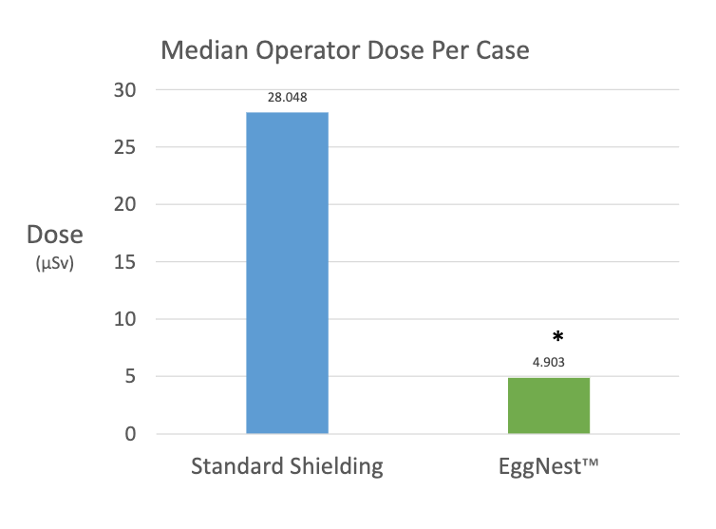
EggNest
EggNest (n=23) vs. standard shielding (n=28) for LHC, RHC, and PCI
4 TLD badges outside of lead at waist/shoulders
EggNest had 90% dose reduction
*p<0.01
Andrew Goldsweig, MD, FSCAI, Lead-Free Radiation Protection, SCAI Scientific Sessions, May 2024.

Slide 10
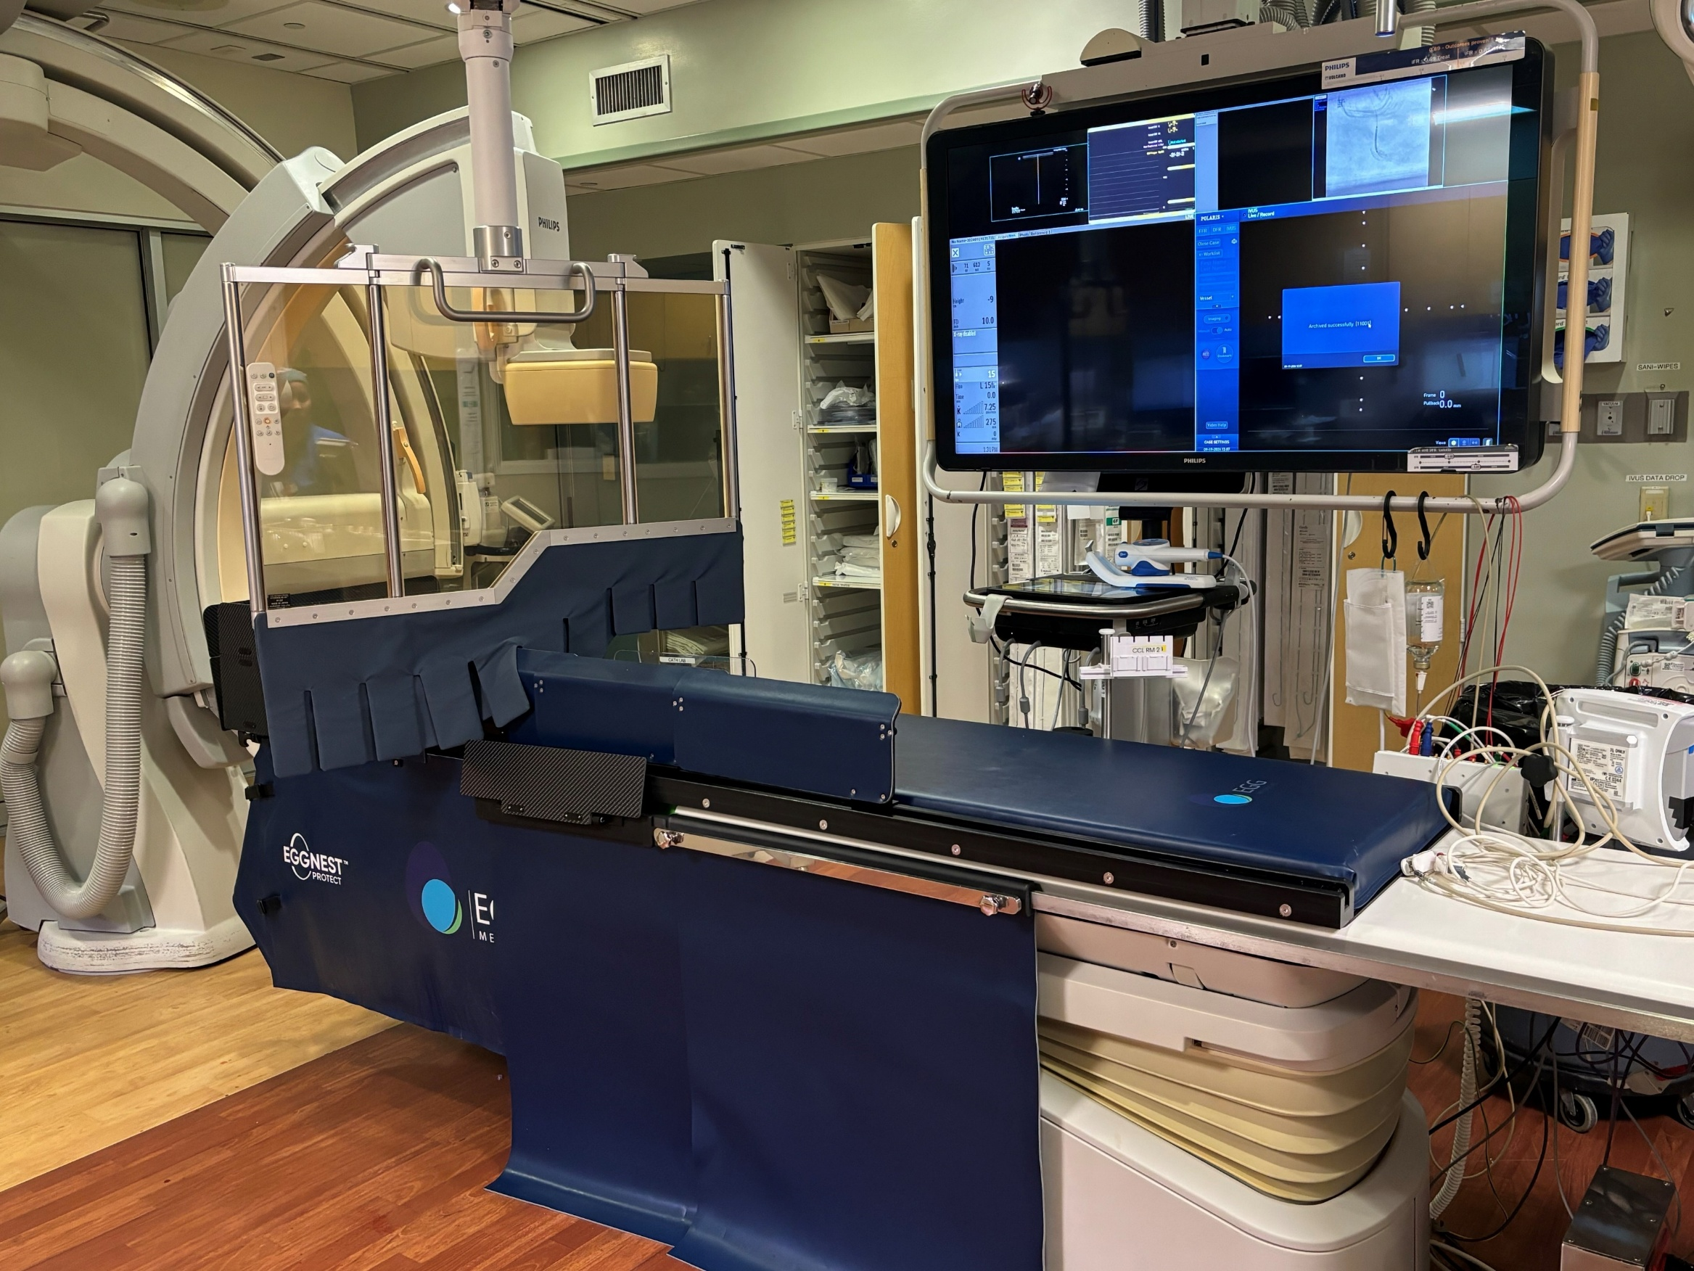
EggNest
Boom-mounted Complete Shield
EggNest Protect™ System is the base platform (Protect™ customers can be converted to Complete™ with addition of Shield)
1mm lead ceiling-mounted Complete Shield
Provides staff with >99% protection
1 sterile drape for Complete Shield
ScatterPro™ disposable
Radial/femoral drape available
Real-time dosimetry system included
Structural
Head Shield
Telescoping
Hip Shield
Flex Shields Move with C-arm
Work Bench with Femoral Flip Shield
Egg Medical
Table Skirt

Slide 11
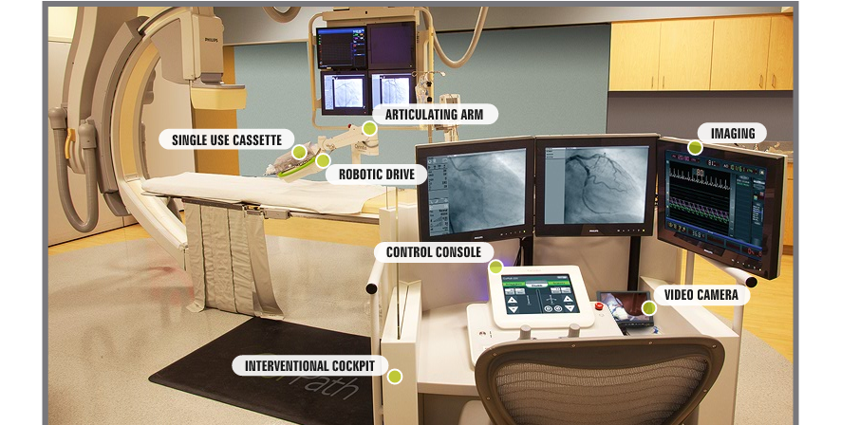
Corindus CorPath
Andrew Goldsweig, MD, FSCAI, Lead-Free Radiation Protection, SCAI Scientific Sessions, May 2024.

Slide 12
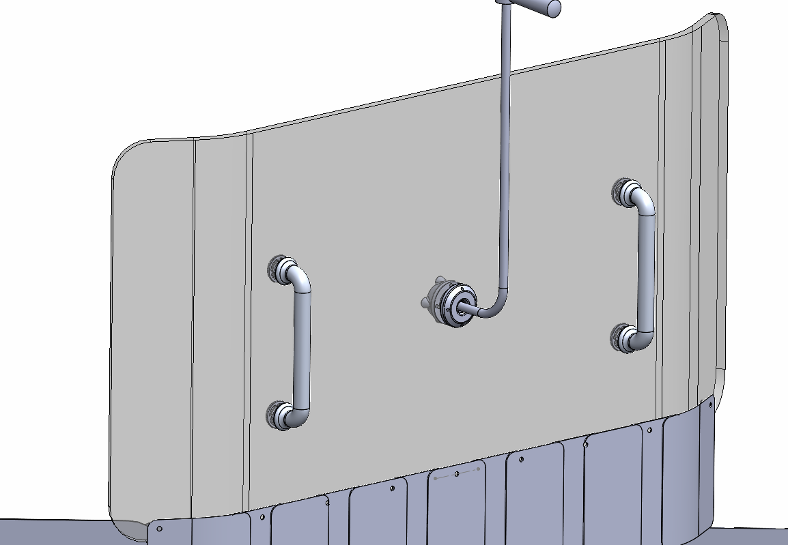
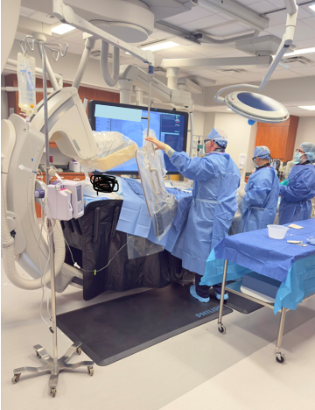
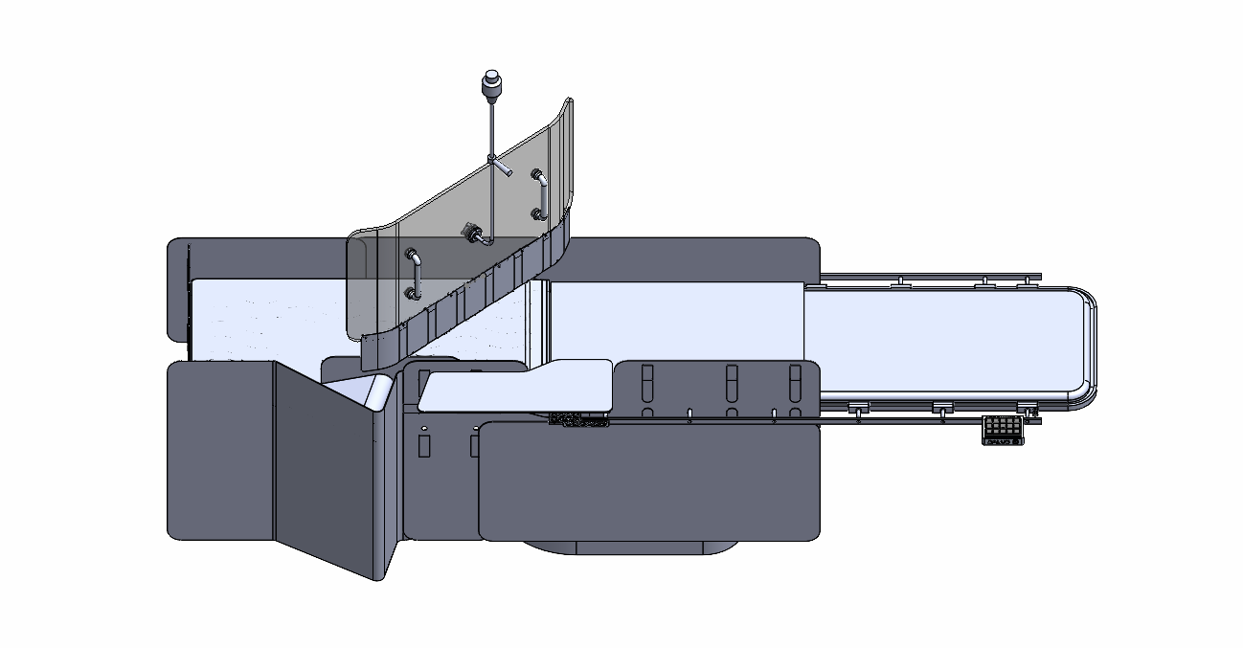
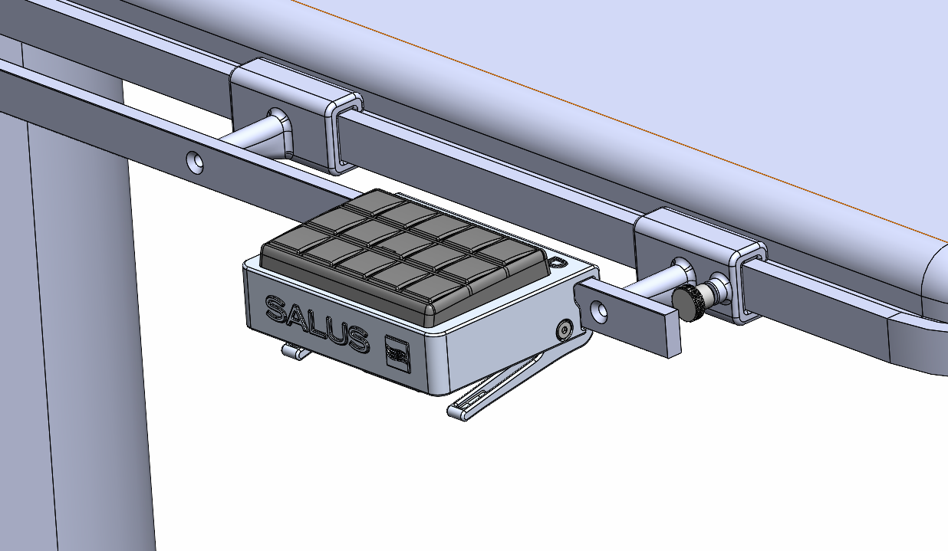
Salus AeroShield™
Table-mounted shield
Inflatable above-table component
Ceiling-mounted hanging shield

Slide 13
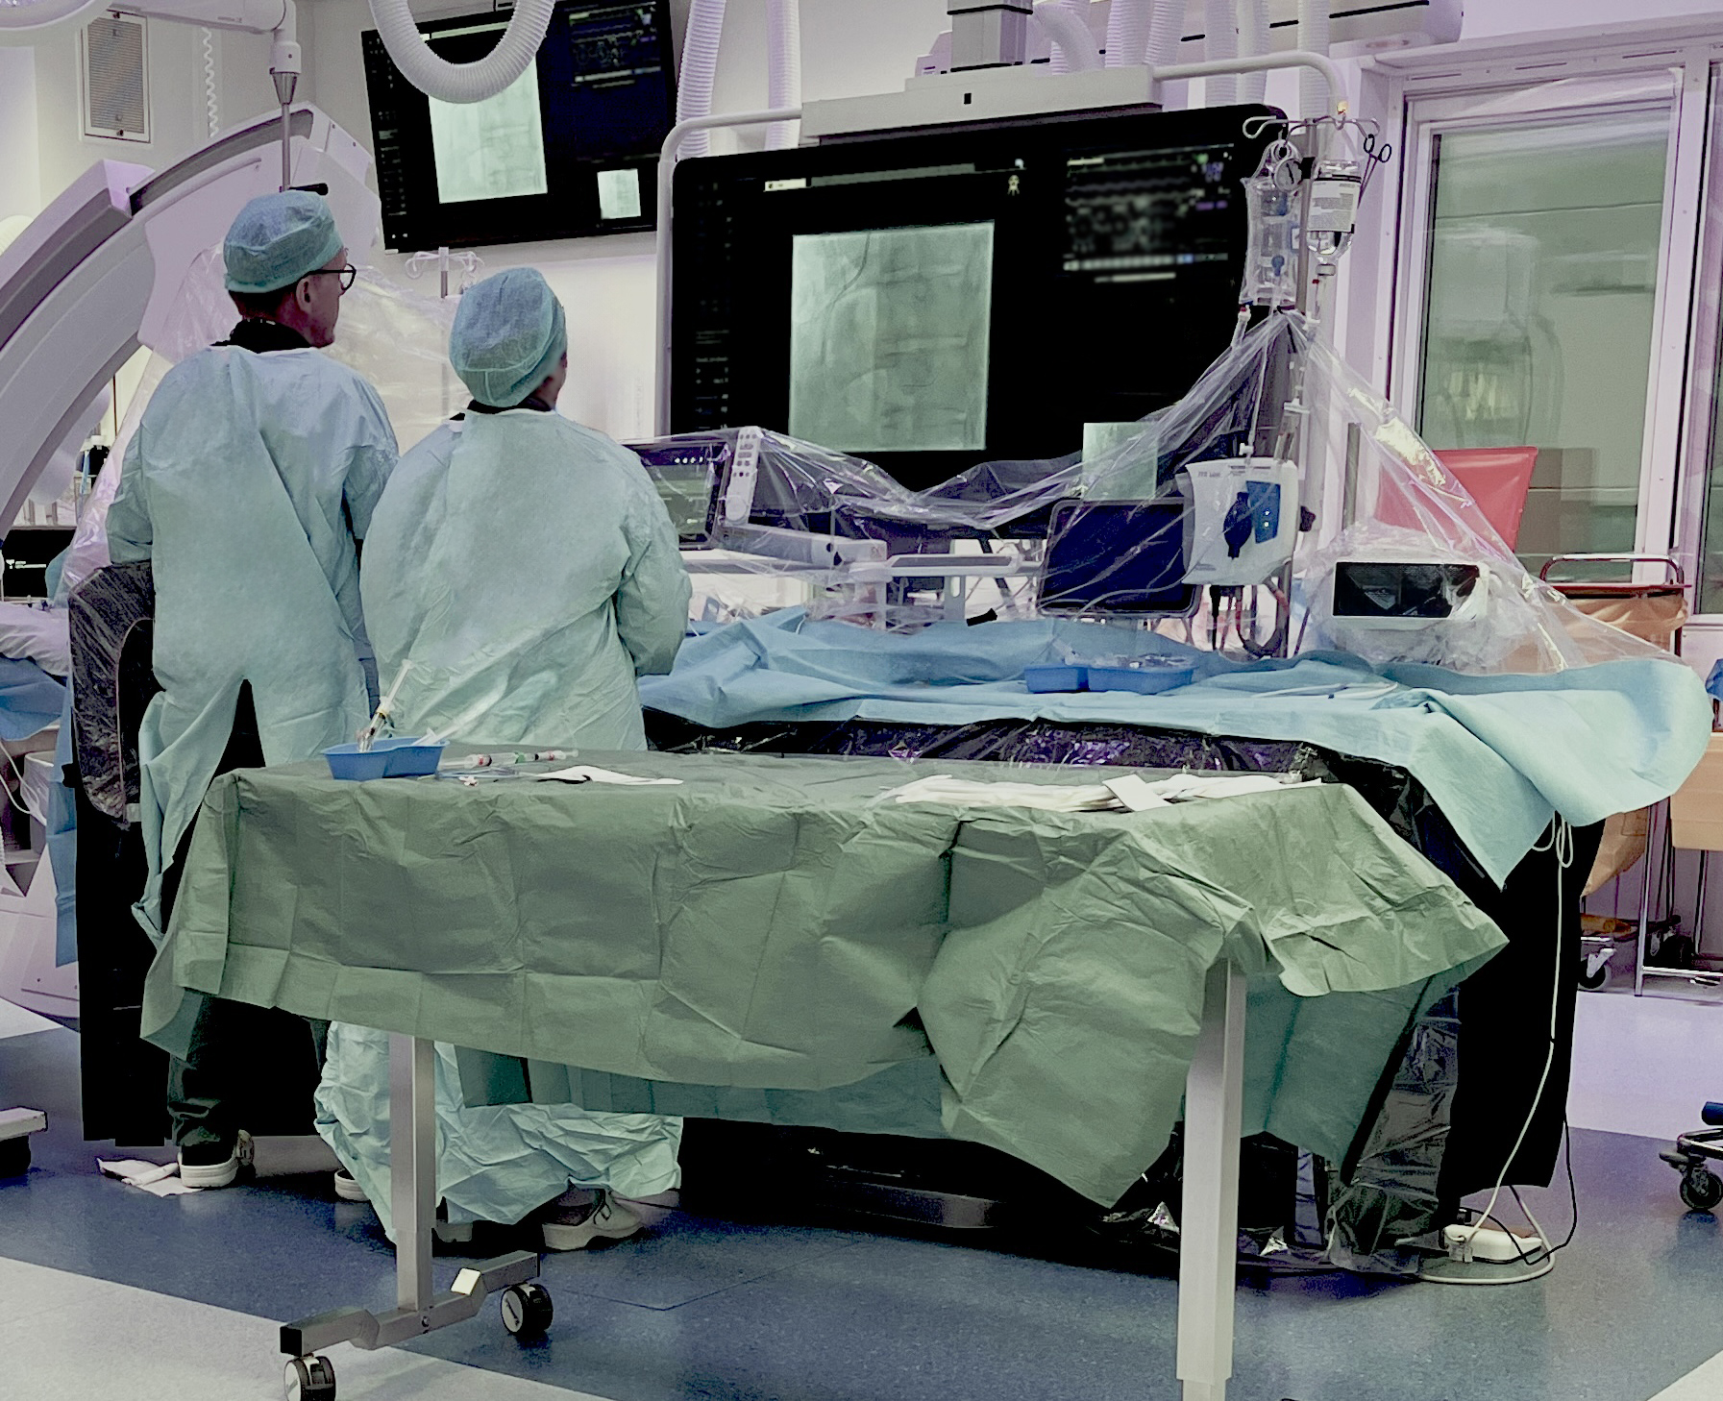
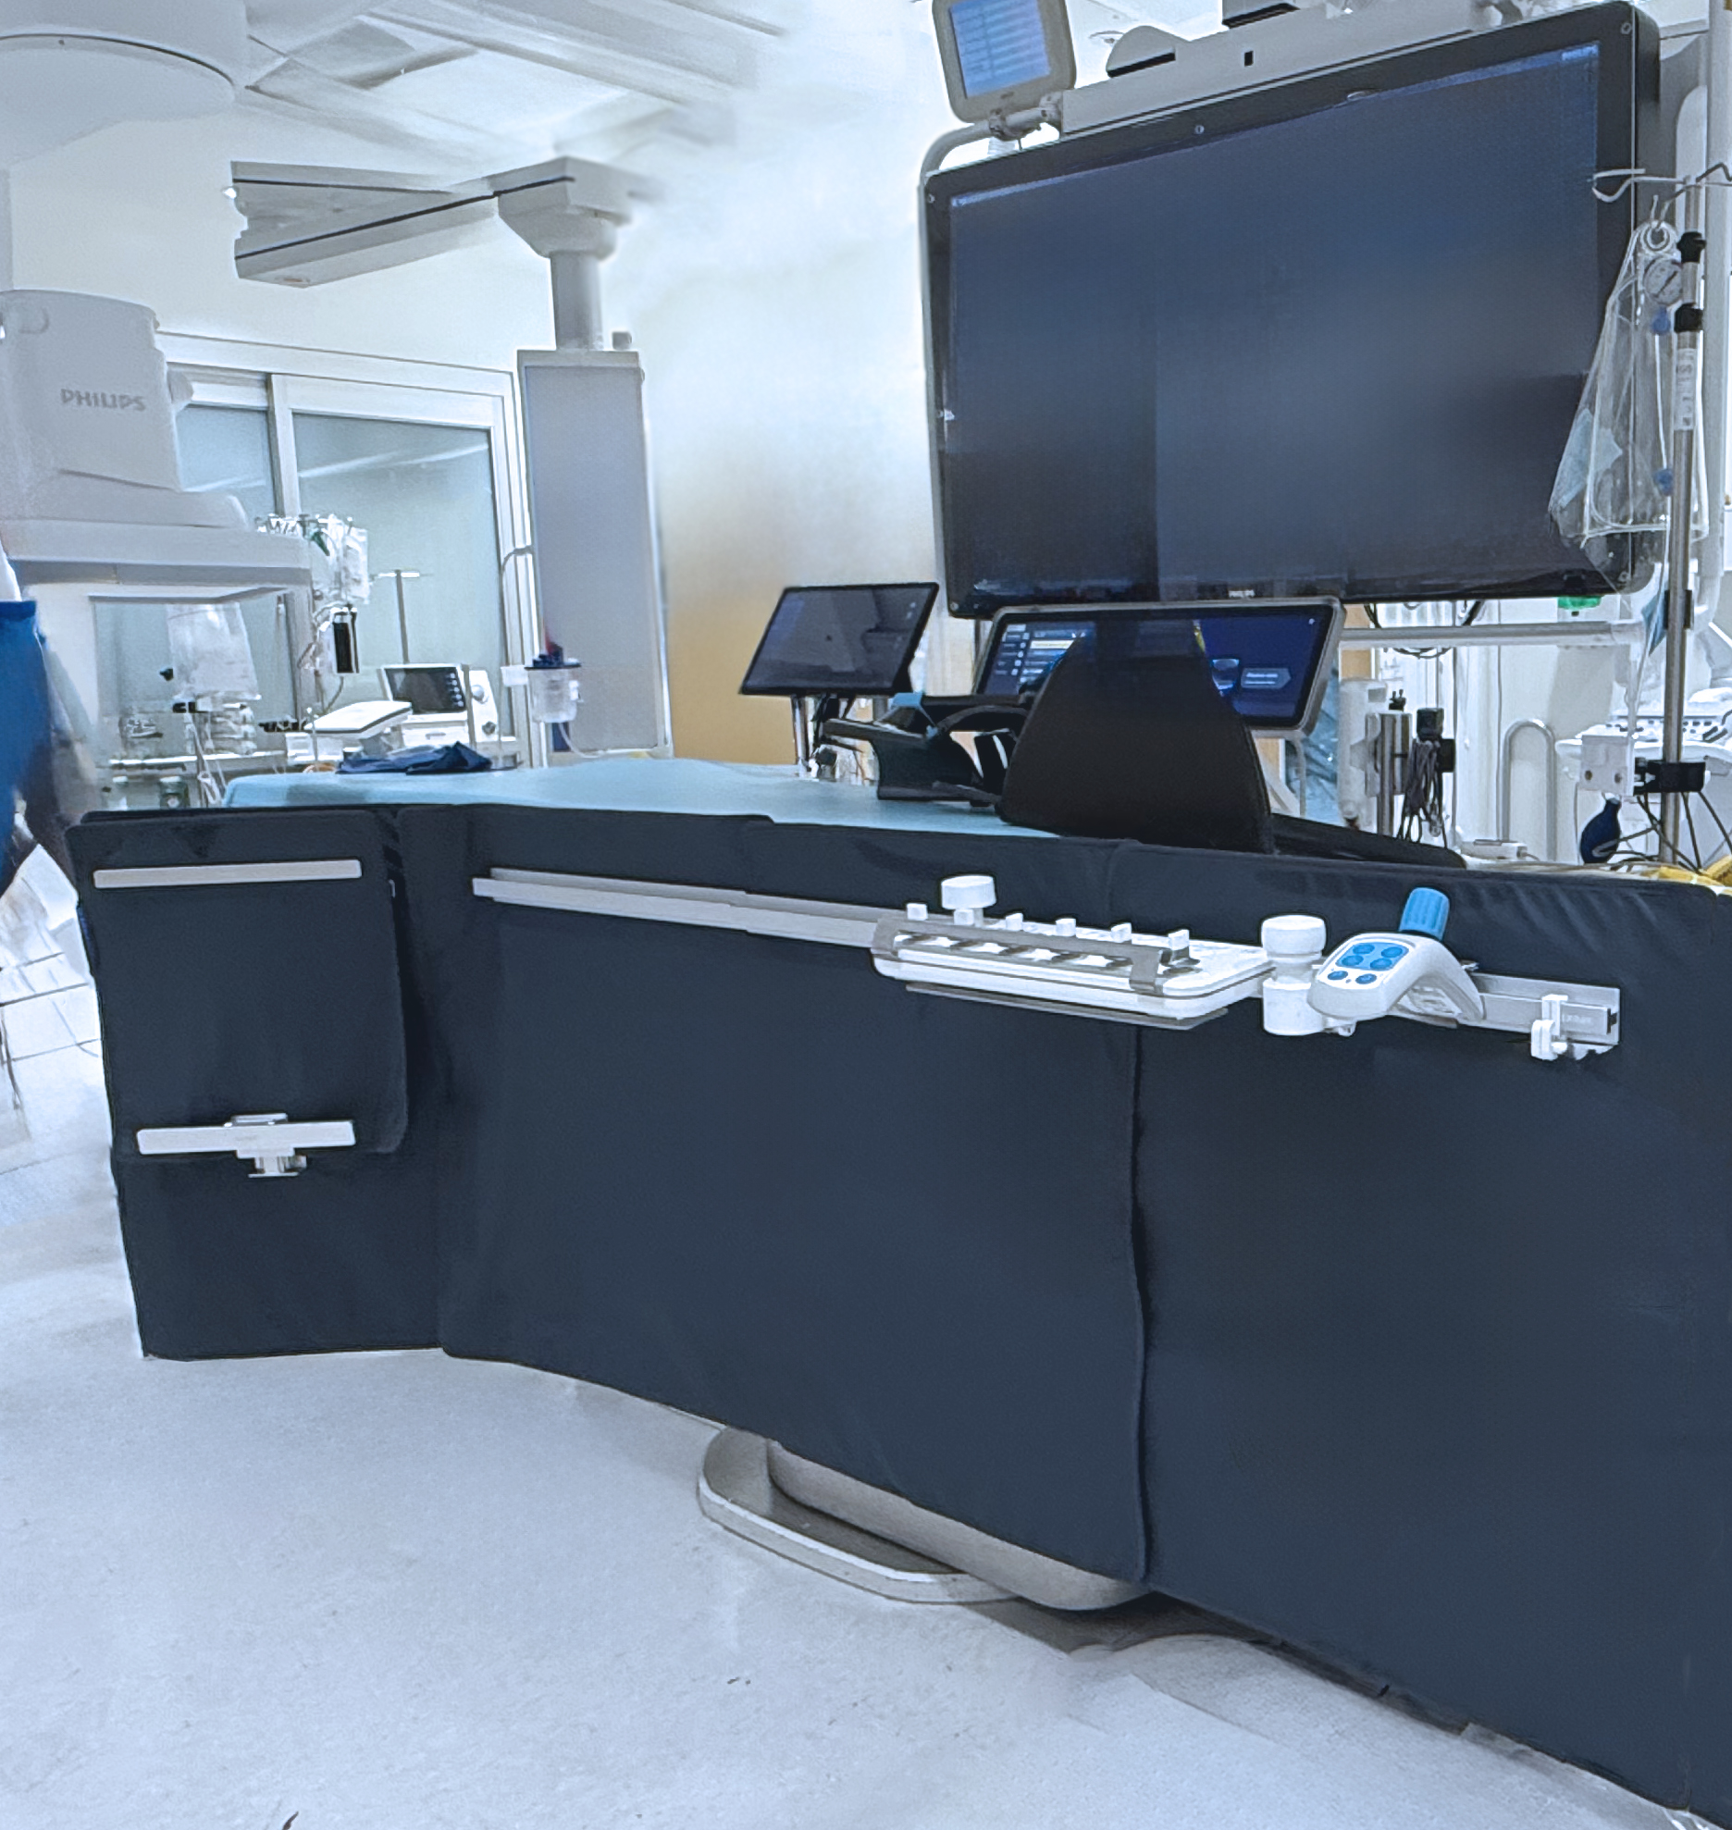
Texray MasterPeace
Textile-based ERPD¹
  Texray textile material is 30 times stronger than
  standard rubber-like sheet materials.
  Soft and pliable.
  Engineered for procedure flexibility.
Integration in clinical environments
  Compatible with existing equipment and accessories.
  Zero-floor fill, no need for retrofitting or reassembly.
Procedural access ^{2,3,4}
  Vertical/Horizontal Table Mounted Shields positioned
  along the table rail, minimal gantry interference.
  Modular Patches draped on the patient, not in field of view.
  Effective patient management during acute procedural complications.
1. Gellerstedt, F., Apell, P., & Haskal, Z. J. (2025). Textile-based radiation protection of staff during fluoroscopic guided interventions: enhancing durability, comfort and safety. CVIR endovascular.
2. Angerås O, Larsson M, Jonasson P, Torild P, Töpel F, Redfors B, Råmunddal T. Evaluation of the TexRay MasterPeace™ enhanced radiation-protection system in cardiac interventions – a cluster randomized controlled study. J Am Coll Cardiol. 2025. Presented at TCT 2025.
3. O. Angerås, Maintaining Radiation Protection During Complication Management: A Case Report Using the Texray MasterPeace™ System in Complex PCI, Sahlgrenska University Hospital, Gothenburg, Sweden, Presented at TCT 2025
4. Bärenfänger F., Bartal G., Hidefjall P., Gellerstedt F., Apell P., Rohde S. Evaluation of a Novel Enhanced Radiation Protection Device in Interventional Neuroradiology: A Phantom Study. Clinical Neuroradiology 2025 (in press).

Slide 14
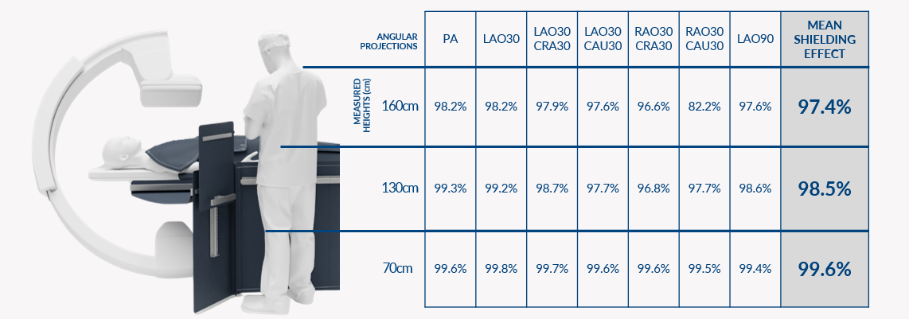
Texray MasterPeace
A phantom study (interventional radiology, biplane setting) demonstrated an average scatter radiation shielding effect of MasterPeace by 99.6% at knee; 98.5% at hip and 97.4% at head levels compared to no shielding across all measured angular projections when used in combination with a standard ceiling-mounted acrylic lead screen.¹
Bärenfänger, F., Bartal, G., Hidefjäll, P., Gellerstedt, F., Apell, P., & Rohde, S. (2025). Evaluation of a Novel Enhanced Radiation Protection Device in Interventional Neuroradiology: a Phantom Study. Clinical Neuroradiology, 1-9.

Slide 15
Enhanced Radiation Protection:
Weight Distribution

Slide 16
Available Options for Advanced Protection: Weight Distribution Systems
Aprons supported from the body, mobile, or ceiling (rather than shoulders)—zero-gravity, Biotronik, VECTOR
Lighter/no lead due to complete shielding from advanced radiation protection systems—e.g., EtherealShield with Xenolite technology
Omar Khalique, MD, FACC, FASE, FSCCT, FSCMR, FSCAI, ALARA Plus: How New Technologies Make Eliminating Radiation and Orthopedic Risks Reasonably Achievable​, SCAI Radiation Summit Presentation, May 2025.​

Slide 17
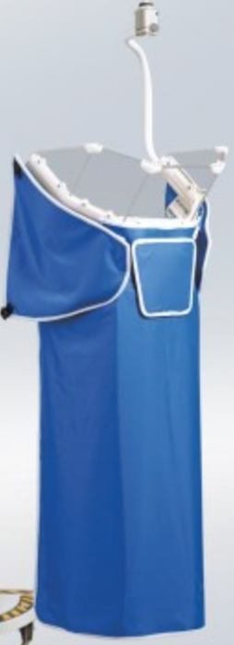
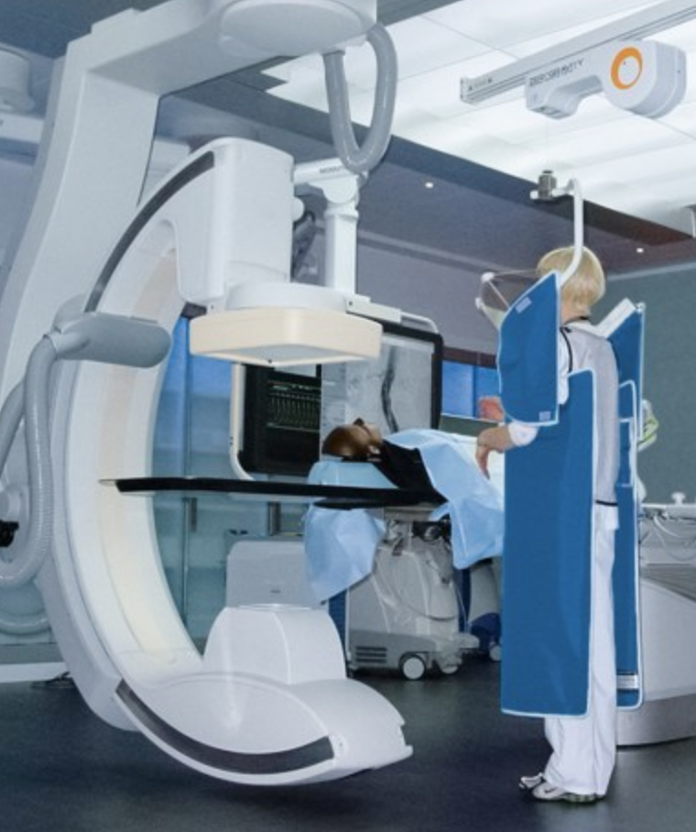
Zero Gravity Suspended Lead
1.0 mm Pb body shield
0.5 mm Pb face shield
More lead than conventional shielding because weight is supported externally
87% dose reduction vs. conventional 0.5 mm Pb gear
Andrew Goldsweig, MD, FSCAI, Lead-Free Radiation Protection, SCAI Scientific Sessions, May 2024.
Notes:
The Zero-Gravity suspended radiation protection system (Biotronik, Lake Oswego, OR) is designed to increase radiation protection while reducing the orthopedic strain of wearing leaded personal protective garments. The system consists of a 1.0 mm lead body shield, suspended from above, that includes arm holes and an attached 0.5 mm lead-equivalent acrylic face shield. Because the system is suspended and the operator does not need to support its weight, Zero-Gravty can offer greater lead-equivalent protection than many leaded garments, which must be light enough to be worn comfortably. The principal trial of this device randomized 126 procedures to Zero-Gravity or conventional angiographic shielding and, although underpowered, reported 87-100% dose and DAP reduction in eye, left temple, neck, humerus, torso, tibia, and back exposure with no change in hand exposure [43].
May be mounted on a ceiling track or on a mobile stand.

Slide 18
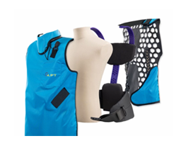
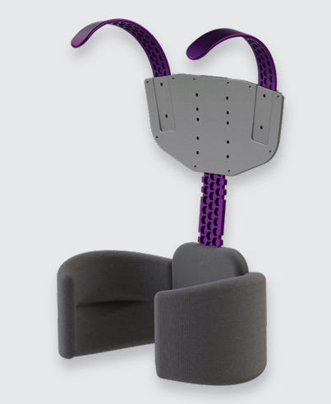
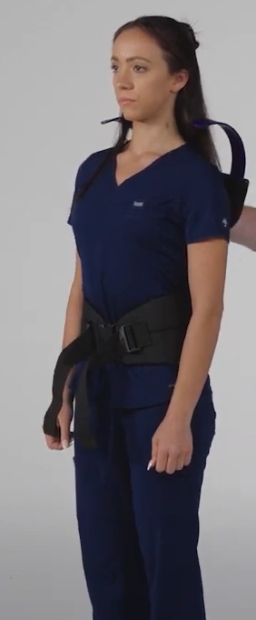
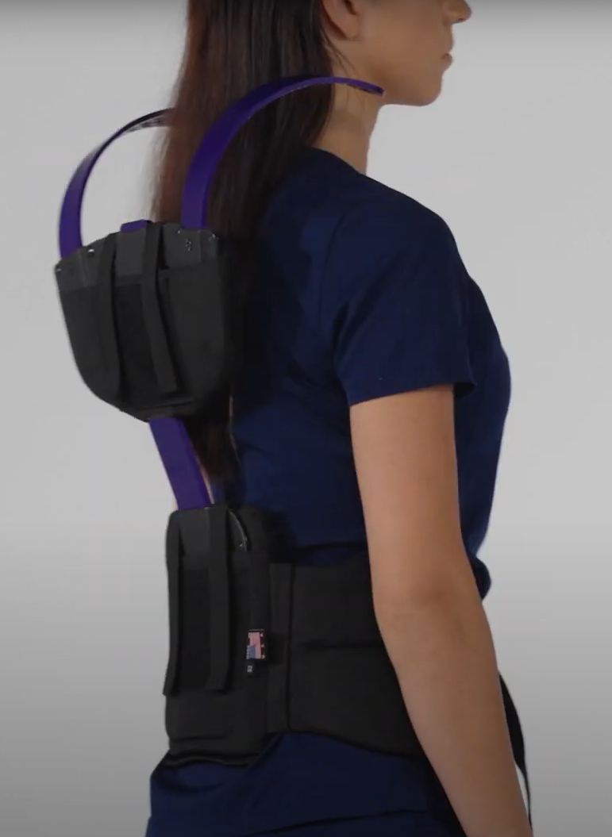
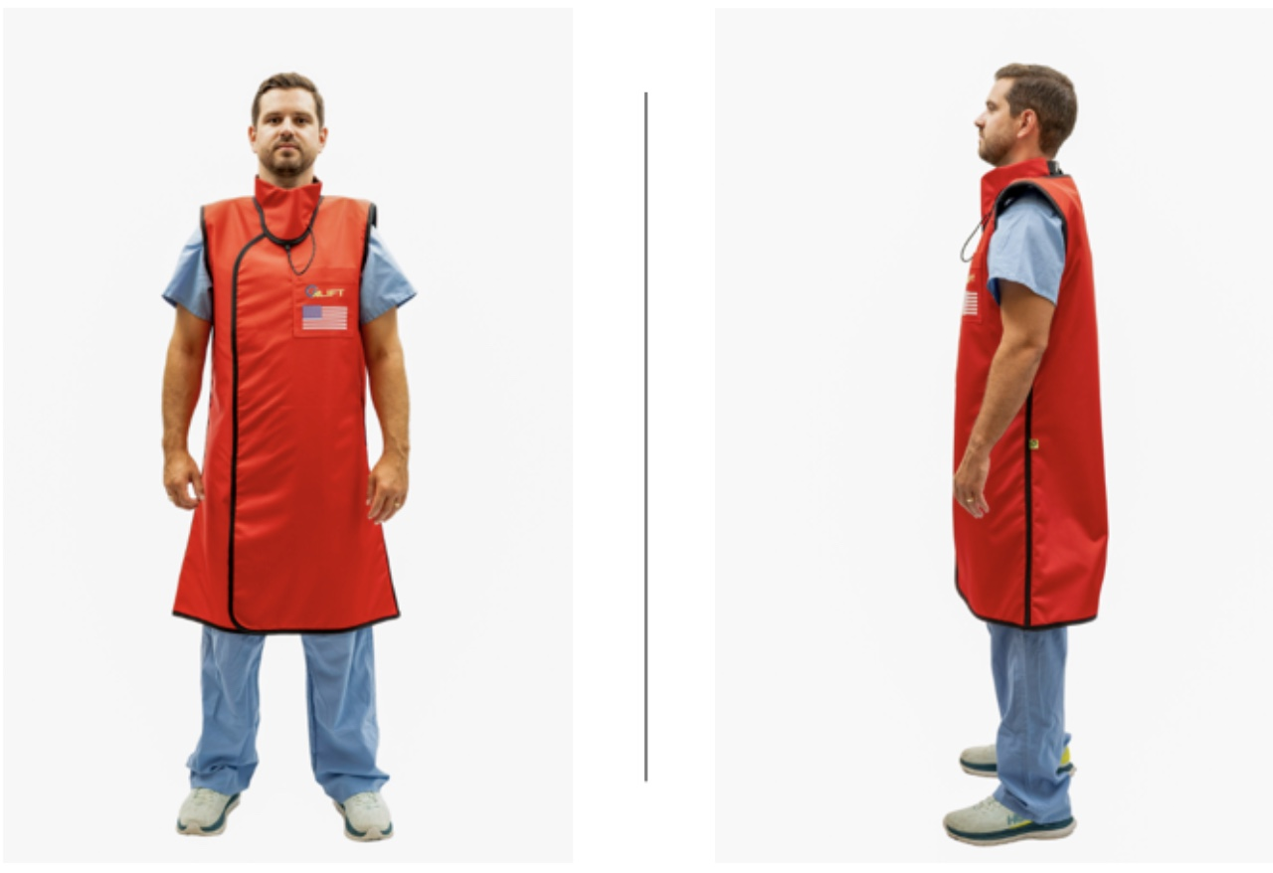

Salus GLiFT™:
A fully ergonomic personal protection garment system
Addresses the orthopedic strain of traditional heavy lead aprons
Patented endoskeleton redistributes weight to relieve shoulder, neck, back strain
Backpacker’s concept
Available in one and two-piece, and in 0.5mm Pb, 0.25mm Pb core material, thyroid collar, sleeves

Slide 19
Talking Points
Training and education should be consistent, standardized, discipline specific, and require requiring periodic renewal¹
Workflows of interventional and non-interventional physicians and CV staff should be considered in the design of cath labs and radiation protection equipment ²
Adoption of enhanced radiation protection technology has been limited across specialties despite availability³
New technologies that further lower radiation dose are available (e.g., imaging modalities, AI integration) or are coming very soon⁴
Investment in real-time dosimetry is critical⁵
1 Steven Kraus, MD, Andrew Bojanowski, Fritz Angle, MD; 2 Omar Khalique, MD; 3 Kyle Jones, PhD; 4 Atul Gupta, MD; 5 Kyle
Bugg
Robert Riley, MD, FSCAI, Multistakeholder Summit on Radiation and Orthopedic Risks in Fluoroscopic Labs​ Summary and Next Steps, SCAI Radiation Summit Presentation, May 2025.​

Slide 20
Enhanced Radiation Protection:
Other Categories

Slide 21
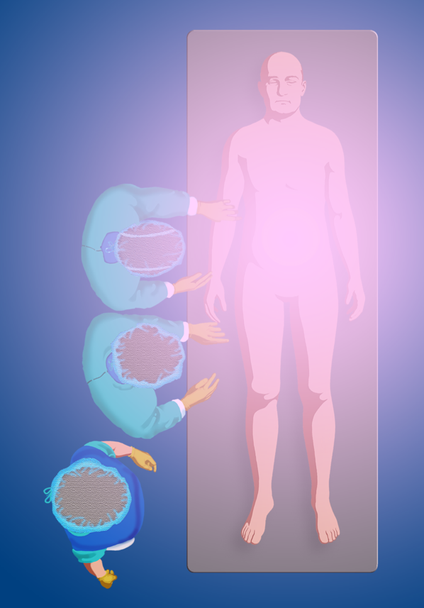
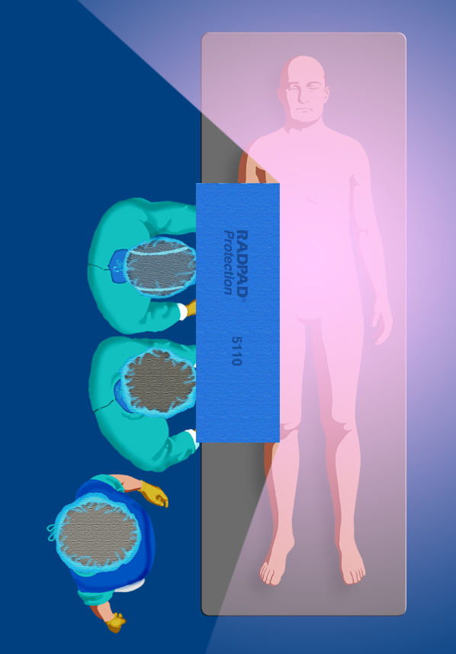
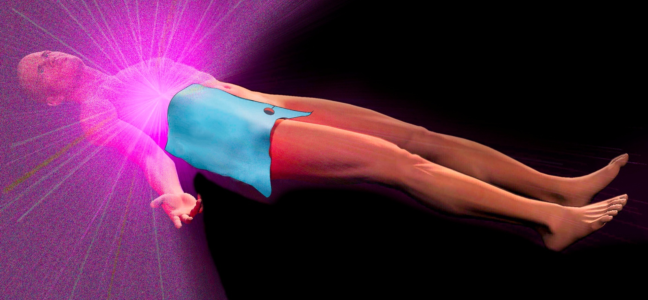
RADPAD® Shade Zone
Omar Khalique, MD, FACC, FASE, FSCCT, FSCMR, FSCAI, ALARA Plus: How New Technologies Make Eliminating Radiation and Orthopedic Risks Reasonably Achievable​, SCAI Radiation Summit Presentation, May 2025.​

Slide 22
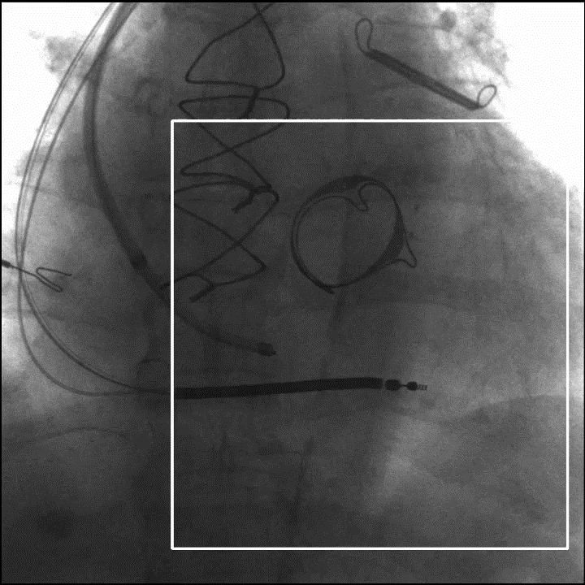
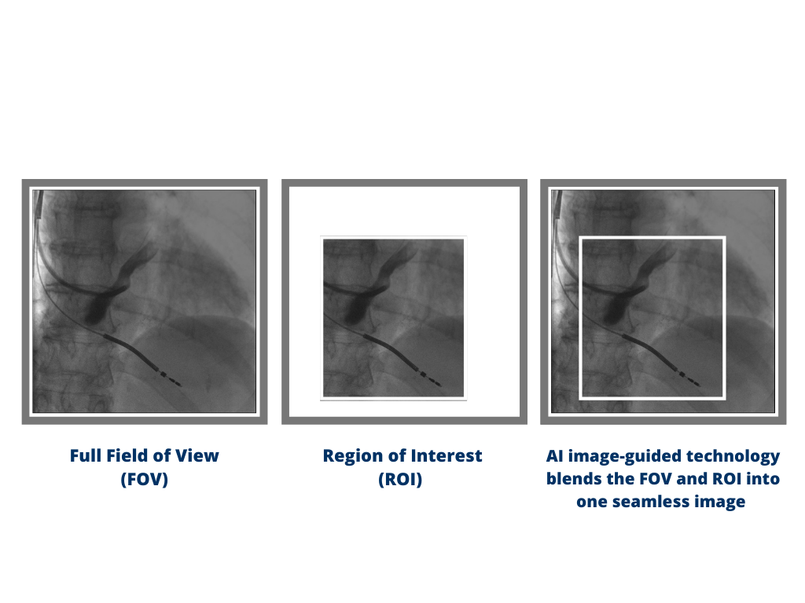
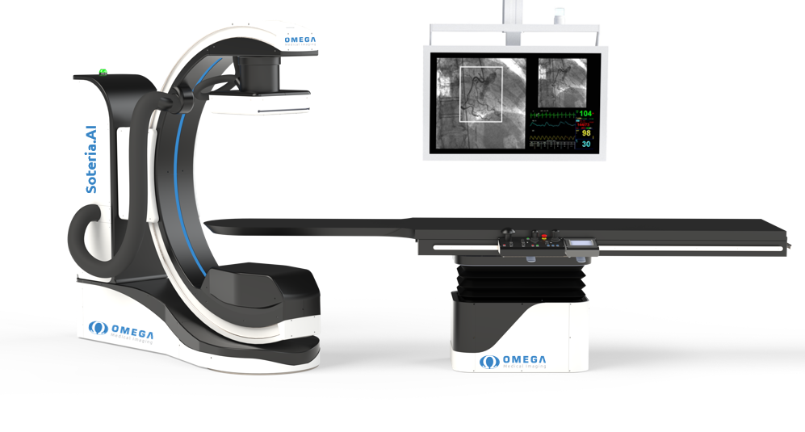
SOTERIA.AI CARDIAC SYSTEM
Omega Medical Imaging
THE ONLY AI-INTEGRATED INTERVENTIONAL X-RAY SYSTEM THAT REDUCES DOSE AND IMRPOVES PATIENT OUTCOMES
Intelligence
Automatically defines and manages the region of interest (ROI) during a case for handsfree performance
Protection
Ultimate radiation protection for everyone in the room – patient, physician, and staff – during fluoro and cine
Goes beyond filtering and completely blocks radiation with fully automated ultra-fast collimation
Confidence
Spectacular image quality – no compromise in image quality inside or outside the region of interest

Slide 23
Radiation Reduction for Patients and Staff
Omega AI image-guided x-ray system provide a significant reduction in radiation for both the patient and staff.
75%
71%
REDUCTION IN RADIATION FOR STAFF
REDUCTION IN RADIATION FOR PATIENTS
Key clinical data: Omega medical imaging - AI image-guided systems (2021) Omega Medical Imaging. Available at: https://www.omegamedicalimaging.com/key-clinical-data/ (Accessed: 15 May 2023).
Omar Khalique, MD, FACC, FASE, FSCCT, FSCMR, FSCAI, ALARA Plus: How New Technologies Make Eliminating Radiation and Orthopedic Risks Reasonably Achievable​, SCAI Radiation Summit Presentation, May 2025.​

Slide 24
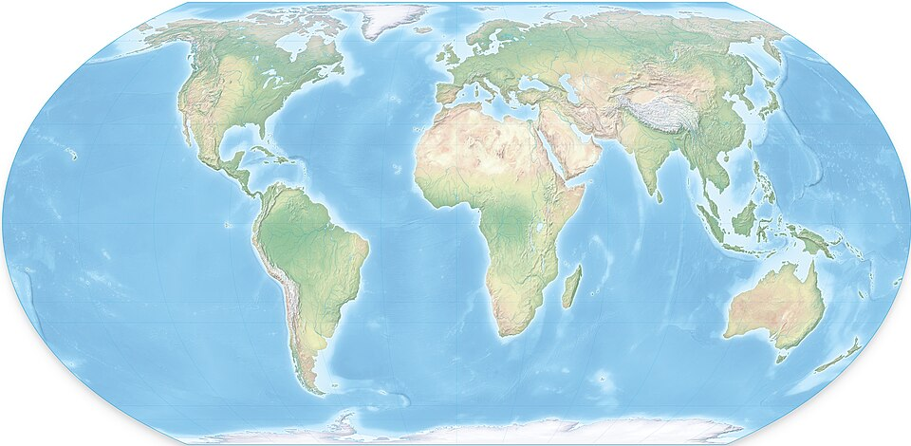
International Perspective
There is some variability in the available tools (especially ERPDs) internationally, but most are making progress to be available
  For example: EggNest, Protego, and Rampart are available
  All three companies have achieved CE mark
  Will require, in some circumstances, that the facility contact a distribution company
  May be challenging to obtain outside Europe

Slide 25
Real Time Dosimetry

Slide 26
How it works
Active, wearable dosimeters measure scatter radiation in the cath lab and stream dose-rate wirelessly to a visible display. ​
Second-by-second feedback shows how tube angle, distance, collimation, frame rate, and shielding change exposure during the case. ​
Multiple badges can be viewed together to build team awareness for operators, nurses, and technologists. ​
Longitudinal data supports benchmarking and quality improvement to sustain ALARA-focused practice and reduce cumulative risk.
In a study of blinded vs. unblinded use of real-time dosimetry among pediatric interventional radiologists, real time monitoring resulted in a 6-fold reduction in exposure (3.01 vs. 0.56 μSv/min, p < 0.05).
Racadio J, Nachabe R, Carelsen B, et al. Effect of Real-Time Radiation Dose Feedback on Pediatric Interventional Radiology Staff Radiation Exposure. J Vasc Interv Radiol. 2014;25(1):119-126. doi:10.1016/j.jvir.2013.08.015

Slide 27
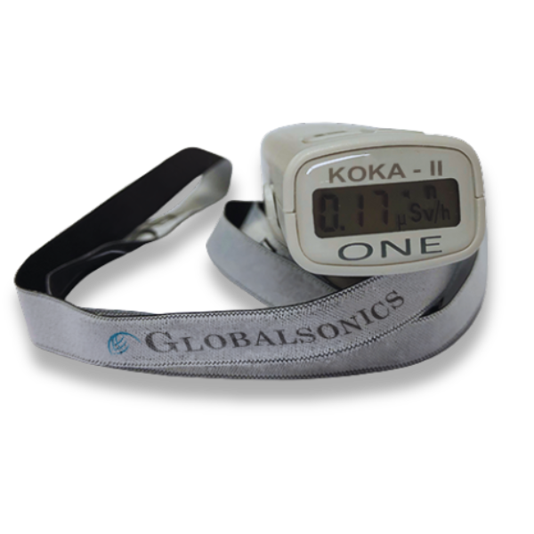
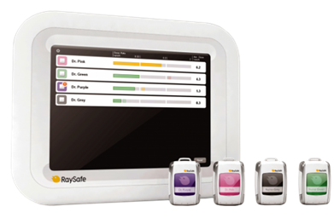
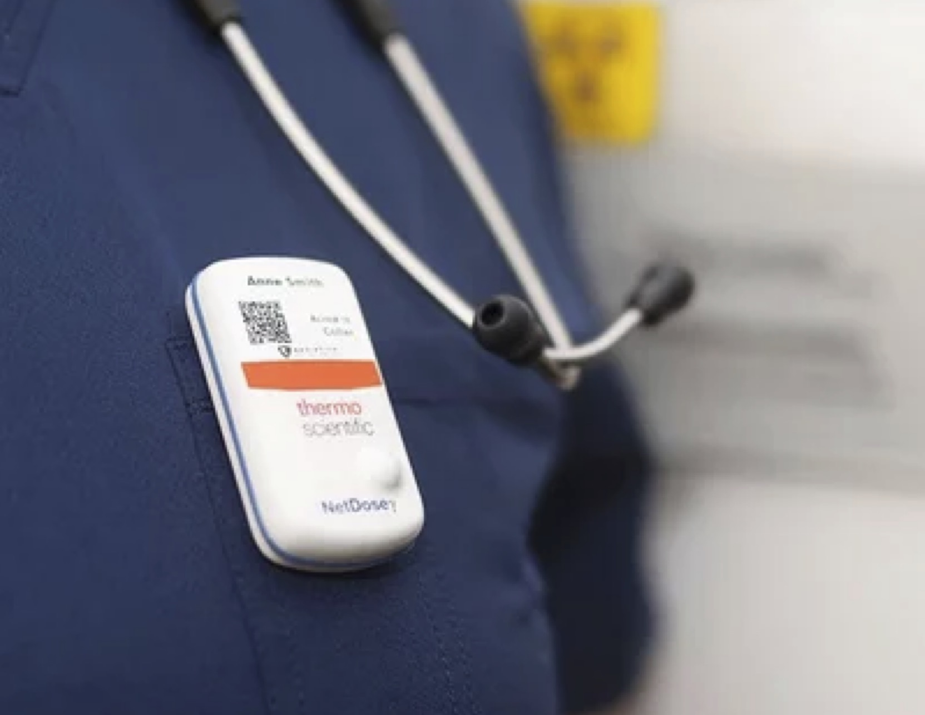
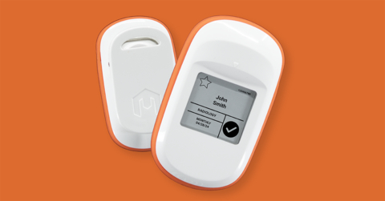
Example Systems

