Slide 1
2026 ALARA+ Toolkit: Government Advocacy
Arnold Seto, MD, FSCAI, Islam Abudayyeh, MD, FSCAI, Allison Dupont, MD, FSCAI, Giorgio Medranda, MD, FSCAI, Faisal Latif, MD, FSCAI

Slide 2

Relevance to SCAI Members
SCAI has made it a focus to address the ongoing issue of cardiac cath lab injury
In most other occupations, the level of injury and disability encountered by operators would be unacceptable
There has not been a significant improvement on mitigation of risk to operators over time
It is incumbent on us to address these issues and pursue solutions—especially as we are asked to do more
We must support colleagues interested in IC as a career, including women—pregnancy should not be a barrier

Slide 3
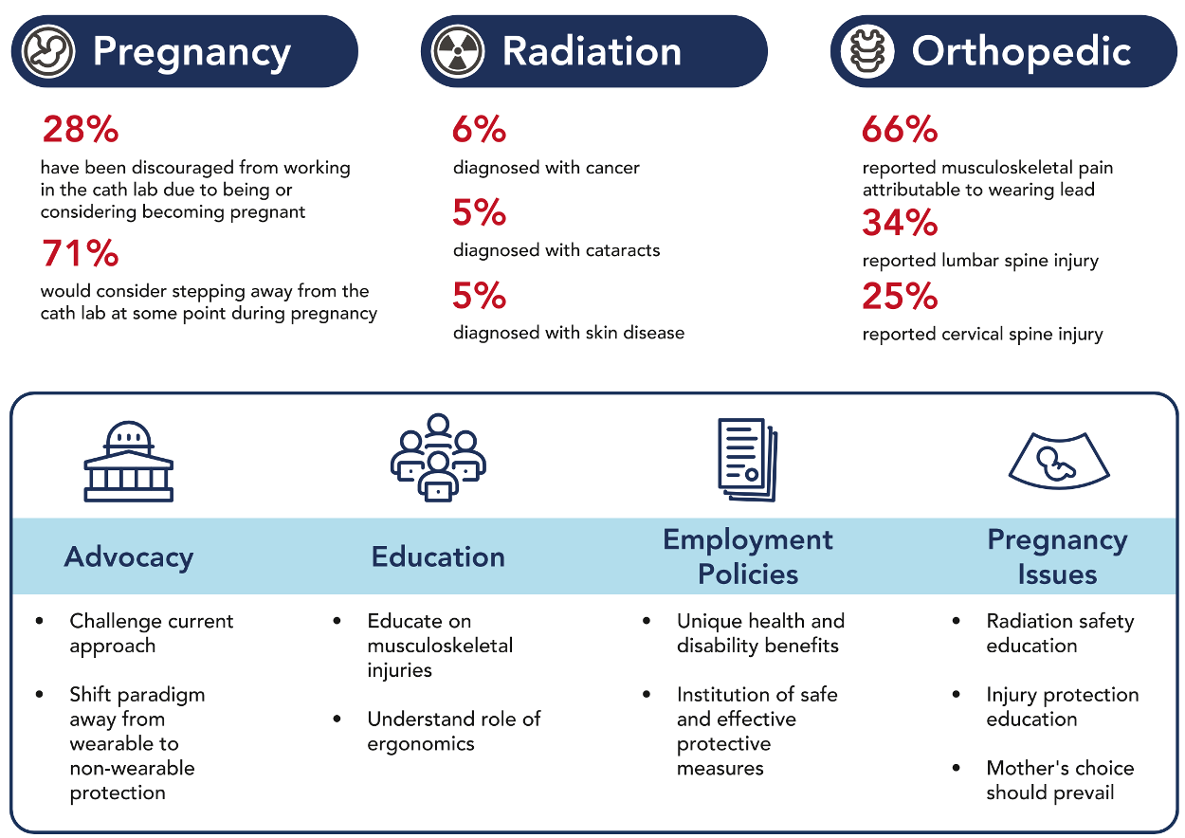
Notes:
Abudayyah I. JSCAI 4(4) 102493 April 2025

Slide 4
ALARA+
As low and light as reasonably achievable
Amends ALARA to incorporate orthopedic risks
SCAI has initiated a coalition of relevant stakeholders including ACC, SIR, SVS, SVIN to facilitate the following:
  Dissemination of best practices with current available technologies
  Broader use and customization of ERPDs
  Continued technological innovation to protect all fluoroscopic lab personnel
  Advocacy at federal and state levels

Slide 5
Existing Laws and Regulations

Slide 6
Background:
Radiation and lab injuries affect physicians in several specialties including cardiovascular, neurovascular, vascular, and radiology. Data from medical colleges and boards show approximately 8,500 physicians in the US and approximately 13,000 nurses and 11,300 technicians involved in fluoroscopy-guided interventional procedures. These numbers continue to increase year-over-year. ¹
All facilities, including federal (VA), follow regulations on the acceptable use of radiation in diagnostic and therapeutic use in medicine. However, these regulations date back to late 1960s and early 1970s and have not been updated to account for changes in procedures or radiation protection.
Ref 1: 2012-2013 IMV Cath Lab Survey.

Slide 7
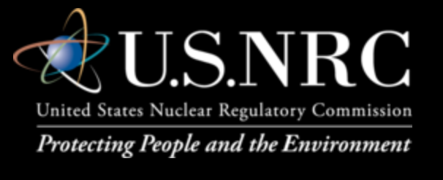
Regulatory Regime in the US –
Federal Government
Food and Drug Administration (FDA)
  Regulates manufacturing of fluoroscopic X-ray systems through the Electronic Product Registration Control (EPRC) provision
Occupational Health and Safety Administration (OSHA)
  Regulates occupational radiation exposure
  Mandates disclosure of exposure to employees
Nuclear Regulatory Commission (NRC)
  Establishes guidelines for dose limits
  Works in partnership with state regulatory authorities

Slide 8
Variability in State-Level Regulation
Responsibility for regulation:
  Department of Public Health – 30 states
  Department of Environmental Protection – 16 states
All states adhere to NRC standard of 5,000 mrem (50 mSv)¹ annual exposure limit
  BUT – ICRP (International Commission on Radiation Protection)² recommends 20 mSv, which has not been widely adopted
Single dosimeter – 48/50 states
Specified training and/or certification – 47/50 states
Site-specific radiation safety programs – 47/50 states
1. Code of Federal Regulations (10 CFR Part 20)
2. ICRP Publication 96, 2005, page 51

Slide 9
State Regulations:
Individual states set their own occupational dose limits, though most adopt the recommendations developed by the National Council on Radiation Protection and Measurements (NCRP).
Medical personnel working in x-ray procedure rooms should wear 0.25- or 0.5-mm equivalent lead aprons augmented with thyroid shields and, when appropriate, humeral shields. Professional societies recommend that protective wraparound aprons with thyroid shields should be used at all times during fluoroscopic procedures.
Additional tools such as shielded caps, glasses, sleeves, or other shielding highly recommended

Slide 10
State Regulations:
These guidelines have not changed over the last few decades, but physician societies are pushing for reforms
Aside from the cost of acquisition, institutions cite regulatory barriers as reasons to not adopt emerging technologies such as enhanced radiation protection devices and shift to a lead-free cath lab
However, the trend is now towards better protection and injury-free workplace. Focus by most regulatory agencies is on both patient and operator safety
Some states (e.g., California) or institutions require recurrent training in the form of radiation-specific CMEs every 2 years or classes
The Veteran's Administration updates regulations in the same way to remain relevant to current technologies. Most recent regulations: VHA Directive 1105.04 Fluoroscopy Safety (Dec 2024)

Slide 11

Perspective of the Administration
There is evolving regulatory language to support changes in radiation protection: it is coming
Get ahead of regulation
Much better to be in the lead and be perceived as proactive, supportive, and pioneering
Showing care for physicians and staff - the messaging is part of the conversation
Improve staff retention
Reduce workplace injury
Reduce the risk of employer liability as more attention is paid to the cath lab work environment

Slide 12
Variation in Barrier Regulations Nationwide
Heterogeneity can make it challenging to adopt next-generation radiation safety devices
Vora, JSCAI 2025

Slide 13
State Laws Requiring Use of Lead Aprons
State-specific laws regarding leaded apron use in medical radiation areas are not uniform across the US, as radiation safety regulations are primarily governed by individual state radiation control programs rather than federal mandates.
However, most states base their regulations on the Conference of Radiation Control Program Directors (CRCPD) Suggested State Regulations (SSR), particularly Part F covering "Medical Diagnostic and Interventional X-ray and Imaging Systems"
Most states require 0.50-mm lead-equivalent coverage for protective aprons, though some states may allow 0.25-mm lead equivalence. The specific requirements vary because:
  Some states are required by law to adopt the SSR verbatim, while others use it as guidance when drafting their own regulations.
  Each state proceeds through its own regulatory process to implement radiation safety standards.
Fisher RF, Applegate KE, Berkowitz LK, et al. AAPM Medical Physics Practice Guideline 12.a: Fluoroscopy Dose Management. Journal of Applied Clinical Medical Physics. 2022;23(3):e13526. doi:10.1002/acm2.13526

Slide 14
State Laws Requiring Use of Lead Aprons
State and institutional regulations do not typically provide exemptions that allow enhanced radiation protection devices (ERPDs) or lead-free protective equipment to replace traditional protective aprons in fluoroscopy laboratories. Rather, regulations specify performance-based requirements (typically 0.50-mm lead equivalence) that both traditional lead and lead-free materials must meet.
By regulations in most states, neither ERPDs nor any other technology currently exempts personnel from wearing protective aprons during fluoroscopy. Further, ERPDs—including suspended radiation protection systems (SRPS), protective scatter-radiation absorbing drapes (PAD), ceiling-mounted shields, and mobile shields—are recommended as adjunctive devices that supplement rather than replace personal protective aprons.
This allows facilities to seek exemptions to the regulation mandating the wearing of leaded aprons. However, this is primarily on a lab-by-lab basis.
The goal is to have language in the regulations that allows catheterization laboratories to install EPDs, and, once verified by a local radiation safety officer, eliminate the requirement for personal shielding.
Hirshfeld JW, Ferrari VA, Bengel FM, et al. 2018 ACC/­HRS/­NASCI/­SCAI/­SCCT Expert Consensus Document on Optimal Use of Ionizing Radiation In Cardiovascular Imaging: Best Practices for Safety and Effectiveness: A Report of the American College of Cardiology Task Force on Expert Consensus Decision Pathways.

Slide 15
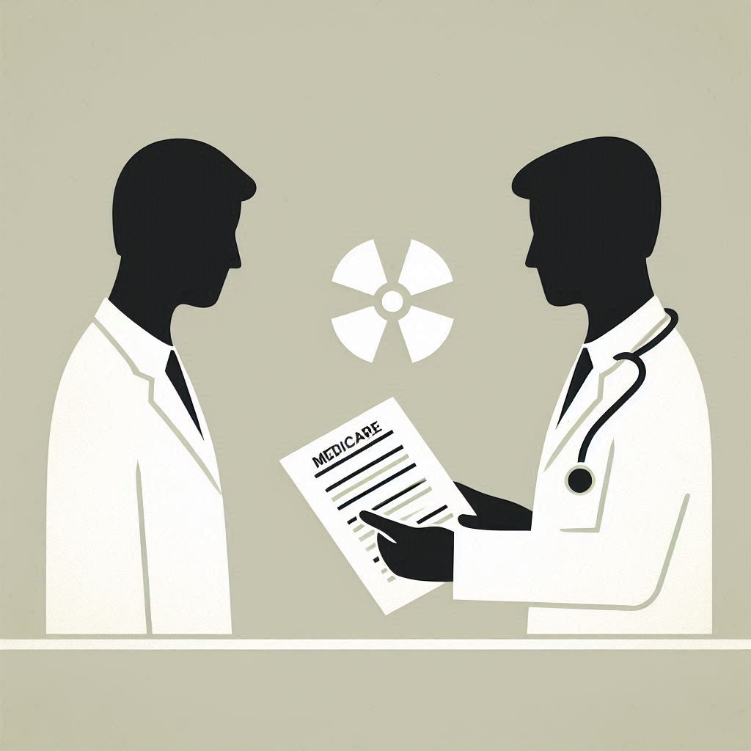
General CoP for Medicare
Medicare Conditions of Participation (CoP) are federal health and safety standards that healthcare facilities must meet to participate in Medicare and Medicaid programs. These standards are the foundation for improving quality and protecting the health and safety of beneficiaries
The CoP requires that radiologic services must be free from hazards for patients and personnel

Slide 16
Medicare CoP Conditions:
Listed under 42 CFR 482.26 (https://www.ecfr.gov/current/title-42/chapter-IV/subchapter-G/part-482/subpart-C/section-482.26)
Adequate shielding:
  Specific definition of what constitutes "adequate" shielding is not defined. Institutions typically will follow state defined or federal regulations as above. Many labs follow recommendations by professional societies (such as SCAI).
Equipment maintenance and inspection (including review by institutional medical engineering and radiation physics QI):
  Compliance is variable and reporting is inconsistent
Professional standards and qualifications:
  As above, reporting and oversight is variable and inconsistent

Slide 17
Medicare CoP Conditions:
Therefore, there is not a specific mandate by Medicare to raise the level of protection. The CoP acts as a minimum needed to participate in services and is insufficient from a professional and safety standpoint.
Other areas not covered:
No regulation or mention of orthopedic protection
No requirement for recurrent training (radiation-specific CME)
No mandates on reporting excessive exposures

Slide 18
How to Advocate for Yourself: Regulatory Bodies

Slide 19
With State and Federal Regulators
Occupational radiation and orthopedic injuries are very costly to the system (annual) :
Based on Value of a Statistical Life (VSL) metric:
  Provider fatal cancers: $9 million per case so at incidence of 1.5–2.5 additional cases per year = $13–$22.5 million
  Provider non-fatal cancers: $200,000 per case so $300,000–$500,000
  Orthopedic injury: $45,000 per incident, so a typical rate of 155–440 incidents per year: $6.9 million
These are costs to the healthcare system based on conservative injury rate assessments and they are rising substantially as more treatments utilize minimal or trans-catheter interventions.
Notes:
ORSIF 2018. Economic Impacts of Radiation Exposures Associated with Interventional Fluoroscopy (https://orsif.org/economic-impact)

Slide 20
With State and Federal Regulators
The current regulations requiring use of aprons makes it difficult to adopt newer and more effective tools such as ERPDs without seeking exemptions. Since not all states follow the same regulatory pathway, this makes it difficult to uniformly apply a single approach.
Most states do follow the guidelines by the National Council on Radiation Protection and Measurements (NCRP), but compliance and certifications vary.

Slide 21
With State and Federal Regulators
Therefore, SCAI and other professional societies advocate for a regulatory pathway to exempt institutions wishing to use ERPDs from the outdated mandates requiring aprons and to recommend changes that bring about a safer fluoroscopy lab work environment. This may initially require creating a variance pathway for these tools.
Invite state and federal regulators to discuss these proposals with SCAI and other professional societies.

Slide 22

International Perspective
Regulations:
  Like the US NRC, Europe has the EURATOM Council Directive
  The regulations are more stringent than those in the US (see next slide)
  Variability in which standards other countries adopt
  Important to create awareness of radiation and ortho injuries in operators and need to protect them
  This is especially important in regions with limited IC availability

Slide 23
International Perspective
Comparison of Key Regulations for Healthcare Operators
 | Europe (EU 2013/59/Euratom) | United States (NRC/EPA)
Occupational Dose Limit (Whole Body) | 20 mSv per year (average) | 50 mSv (5 rem) per year
Eye Lens Dose Limit | 20 mSv/year (recently lowered) | 150 mSv (15 rem) per year
Pregnancy (Fetal Dose) | 1 mSv from notification to birth | 5 mSv (0.5 rem) over gestation
Regulatory Style | Highly prescriptive, unified directives | Risk-based, often delegated to states
Device Regulation | EU MDR: Stricter post-market clinical surveillance | FDA: 510(k) pathway, focus on premarket approval

