Slide 1
2026 ALARA+ Toolkit: Economic Argument
Arnold Seto, MD, FSCAI, Islam Abudayyeh, MD, FSCAI, Allison Dupont, MD, FSCAI, Giorgio Medranda, MD, FSCAI, Faisal Latif, MD, FSCAI

Slide 2

Relevance to SCAI Members
SCAI has made it a focus to address the ongoing issue of cardiac cath lab injury
In most other occupations, the level of injury and disability encountered by operators would be unacceptable
There has not been a significant improvement our mitigation of risk to operators over time
It is incumbent on us to address these issues and pursue solutions—especially as we are asked to do more
We must support colleagues interested in IC as a career, including women—pregnancy should not be a barrier

Slide 3
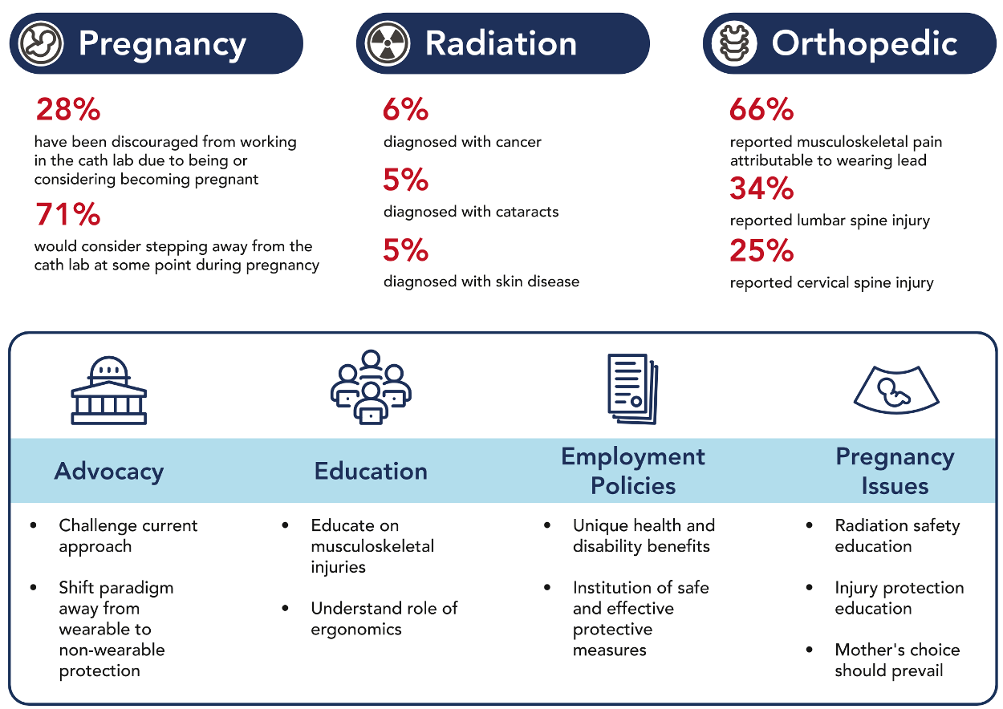

Slide 4
ALARA+
As low and light as reasonably achievable
Amends ALARA to incorporate orthopedic risks
SCAI has initiated a coalition of relevant stakeholders including ACC, SIR, SVS, SVIN to facilitate the following:
  Dissemination of best practices with current available technologies
  Broader use and customization of ERPDs
  Continued technological innovation to protect all fluoroscopic lab personnel
  Advocacy at federal and state levels

Slide 5
Economic Considerations for the Hospital

Slide 6
Clinical and Economical Discussion Points
Clinical Justification
Economical Argument/Concerns
Other Considerations
Greatly reduce/almost eliminate occupational exposure^{1,2}
Eliminate many heavy lead/lead equivalent aprons ^{1,2}
Physician/staff engagement and satisfaction³
Revenue/contribution?
No reimbursement for these devices
Not billable
Cost avoidance
Functionality/
compatibility
Equal access across IDNs
Avenue(s) to acquisition
Programmatic opportunity
Kyle Bugg, MBA, RT(R), Proactive Radiation Safety: Spend Now to Save Later, SCAI Radiation Summit Presentation, May 2025.​
Notes:
1. RAMPART ic. (n.d.). RAMPART Ic. Retrieved April 17, 2025, from https://www.rampartic.com/
2. Scatter Radiation Protection for the entire Cath Lab team | The EggNestTM. (2025, March 17). Egg Medical. https://eggmedical.com/
3. Abudayyeh, I., Dupont, A. G., Hermiller, J. B., Mascarenhas, J., Velagapudi, P., Ijioma, N. N., Duffy, P. L., Kolansky, D. M., Cigarroa, J., Scantlebury, D. C., Skelding, K., & Klein, A. J. (2025). Occupational Health Hazards in the Cardiac Catheterization Laboratory: Results of the 2023 SCAI Survey. Journal of the Society for Cardiovascular Angiography & Interventions, 102493. https://doi.org/10.1016/j.jscai.2024.102493

Slide 7
Non-Monetary Costs We Should Aim to Avoid
Costs to our communities:
Potential loss of physician/clinician availability
Potential reduction in capacity to treat
Potential reduction in hospital’s community engagement
Costs to the hospital/organization:
Potential loss of revenue
Recruiting cycles may occur more frequently
Potential worker’s comp cases, payments, and premiums may increase
Potential long-term litigation exposure
Kyle Bugg, MBA, RT(R), Proactive Radiation Safety: Spend Now to Save Later, SCAI Radiation Summit Presentation, May 2025.​

Slide 8
The Incidence of Injury:
Prevalence among ICs:
9.4% of ICs report injury-related absence from work
Almost half (49.4%) report workplace implications
Majority of these injuries are (as described previously) related to ortho injuries
Cath labs cost $25-$35 per minute during operations.
Any delay or shutdown has significant fixed costs to the system.
Blankenship JC, Choi JW, Das TS, et al. SCAI/­ACVP Expert Consensus Statement on Cardiovascular Catheterization Laboratory Economics: If the Cath Lab Is Your Home You Should Understand Its Finances. Catheterization and Cardiovascular Interventions : Official Journal of the Society for Cardiac Angiography & Interventions. 2019;94(1):123-135. doi:10.1002/ccd.28330.

Slide 9
The Costs of Injury:
Typical costs to the hospital/organization:
Average interventional procedure costs ~$9,000, diagnostic $1,700
Based on that, an absence of 1-day results in $5,000–$15,000 in losses to the institution
For a moderate duration absence (e.g., 4-12 weeks), total indirect costs reach $100,000–$600,000+, factoring in immediate lost revenue
Long-term strategic impacts on market position and referral patterns result in higher loss of productivity for the institution in a highly competitive environment
Blankenship JC, Choi JW, Das TS, et al. SCAI/­ACVP Expert Consensus Statement on Cardiovascular Catheterization Laboratory Economics: If the Cath Lab Is Your Home You Should Understand Its Finances. Catheterization and Cardiovascular Interventions : Official Journal of the Society for Cardiac Angiography & Interventions. 2019;94(1):123-135. doi:10.1002/ccd.28330.

Slide 10
Cost Avoidance: A Real-World Scenario
To provide advanced radiation protection for all of its cath labs, Hospital A would need to invest approximately $1.4 million; this investment would aid in protecting 909 annual procedures and more than $15 million in revenue generation for a single cardiologist.
Kyle Bugg, MBA, RT(R), Proactive Radiation Safety: Spend Now to Save Later, SCAI Radiation Summit Presentation, May 2025.​

Slide 11
The (Potentially) Never-Ending Recruiting Cycle
This is not an interventional cardiologist-specific concern
  Interventional radiologists
  Interventional neurologists
  Vascular interventionalists/surgeons
  Technologists and nurses in these procedural areas
Currently more than 42,000 open full-time positions in US for technologists and RNs
Costs of recruiting new physicians can range from $500,000 to more than $1million in addition to lost revenue due to open positions
Locum tenens physicians can command a 10%+ premium
Contract labor cath lab staff members can command a 100%+ premium, though the use of contract labor is subsiding post-COVID
Kyle Bugg, MBA, RT(R), Proactive Radiation Safety: Spend Now to Save Later, SCAI Radiation Summit Presentation, May 2025.​

Slide 12
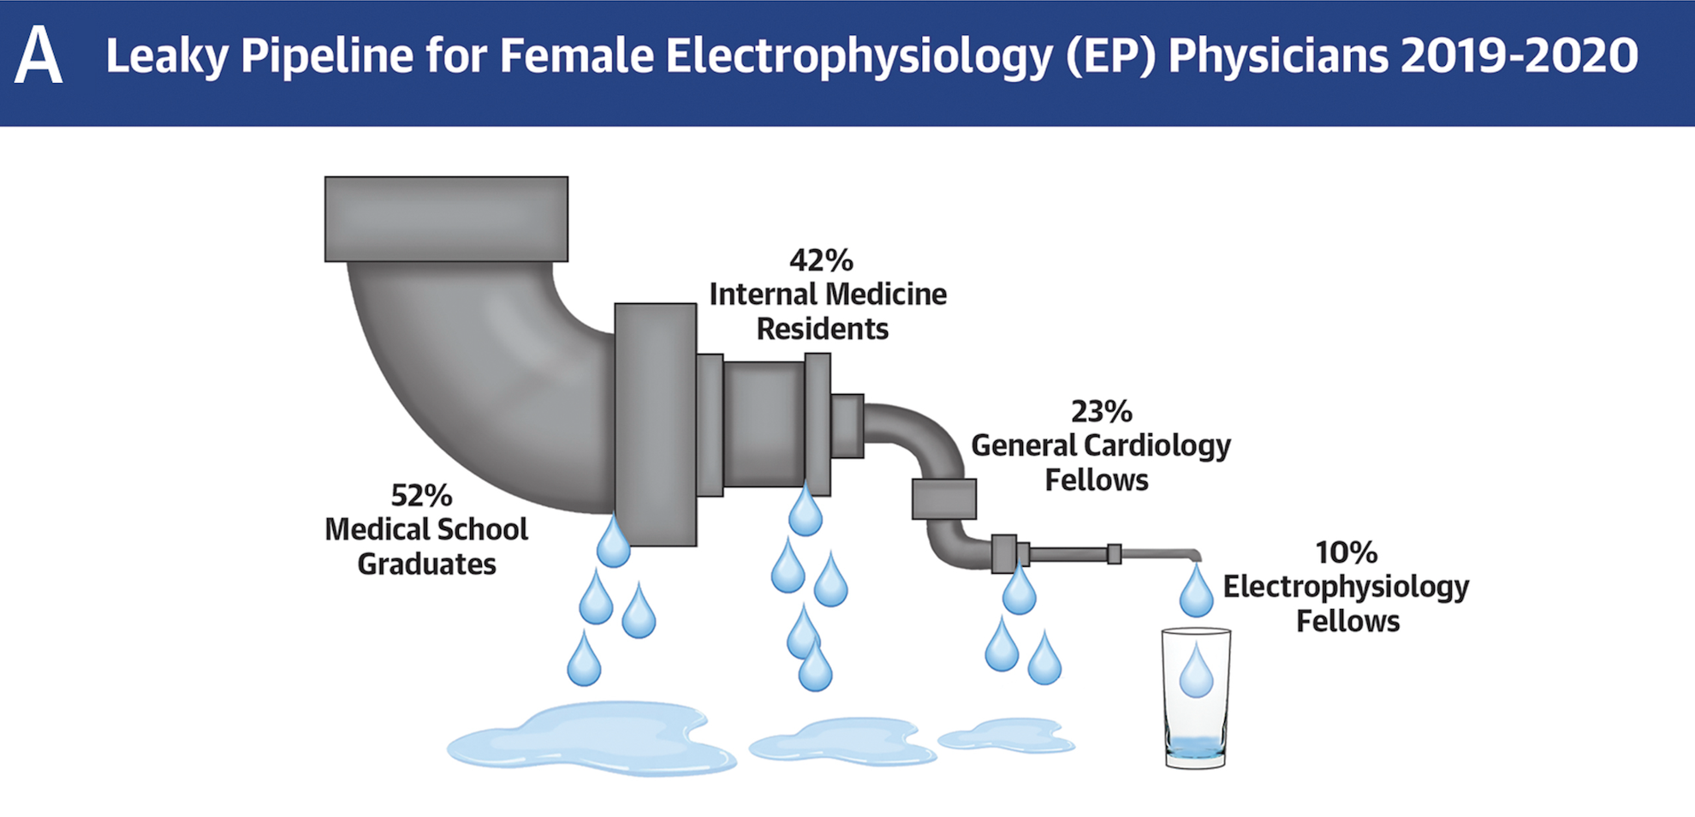
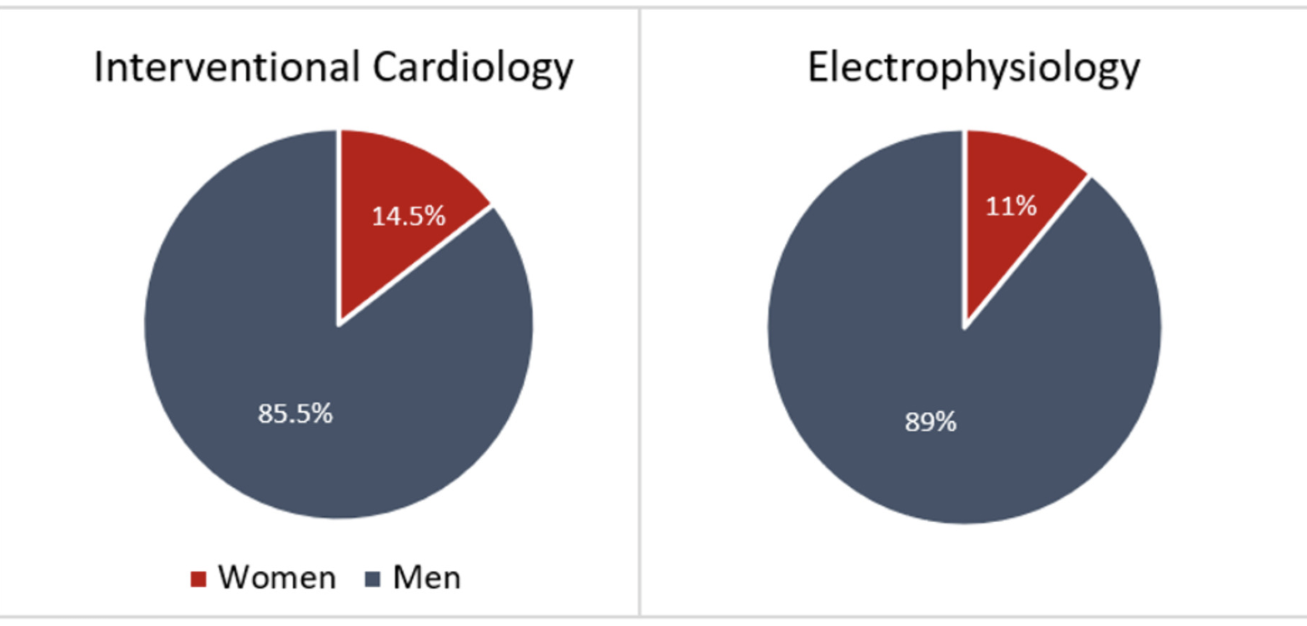
Workforce Retention Crisis
Erin D. Michos, Annabelle Volgman, Kamala P. Tamirisa et al. JACC 2021; 78:910-913.
https://doi.org/10.1016/j.jacadv.2025.101642
Hayes et al
https://www.aamc.org/data-reports/report/us-physician-workforce-data-dashboard
Kamala P. Tamirisa, MD, FHRS, FACC, MSCMR, The Toll of Radiation and Lead on Physicians and CV Professionals: A Female Perspective​, SCAI Radiation Summit Presentation, May 2025.​
Notes:
The American Board of Internal Medicine reported that female physicians made up only 9% to 18% of first-year EP fellows and 7% to 12% of IC fellows over this same 10-year period

Slide 13
Financial Planning
Allocating the funds:
Consider the funding pathways (e.g., federal (VA), state, or county vs. private or corporate)
For state, federal, or county—expect to make requests on a specific schedule and follow a capital cost process cycle which can take 6–18 months!
Also prepare a pro-forma to help your administrator make the argument to their team
Physician time, injury, and time off/disability
A single cath lab operation costs around $18K per day. A full protection unit can be paid for in 12 workdays of a single lab!

Slide 14
How to Advocate for Yourself: Economic Argument

Slide 15

With Administration
Safety and well-being of operators
Clinical necessity
Regulatory compliance
Operational efficiency
Employee well-being and satisfaction
Financial justification
Risk management

Slide 16
With Administration
Employee satisfaction and efficient workflow
Shows the administration is attentive and willing to proactively protect staff
Investment in the most productive members of the facility
Improve workflows (average cath lab operating cost of $25–$35 per minute) so any improvement in workflow has substantial cost savings and financial outcomes to the institution
Protect other colleagues—anesthesiology and imaging
A recruitment tool—staff is now much more aware of orthopedic and radiation injury

Slide 17
With Administration
Regulatory compliance and risk mitigation
Get ahead of regulation being pushed by professional societies.
  Can make the changes now and be seen as a leader and proactive or do it later when it is more costly
Reduce the risk of liability as more attention is paid to the cath lab work environment risk
Diminished competitiveness of the facility compared to others who adopt these tools
Reduced cath lab productivity due to ortho injuries, fatigue, and concern over radiation exposures
Replacement costs: An interventional physician out of the lab for injury will cost upwards of $900,000 in productivity lost.

Slide 18

With Administration
Financial considerations
Consider the funding pathways (e.g., federal (VA), state, or county vs. private or corporate)
For state, federal or county—expect to make requests on a specific schedule and follow a capital cost process cycle which can take 6–18 months!
Also prepare a pro-forma to help your administrator make the argument to their team
  Physician time—injury and time off/disability
      A single cath lab costs around $18,000 per day. A full protection unit can be paid for in 12 workdays of a single lab!

Slide 19
Overcoming Barriers
Cost: The upfront cost of new equipment can be significant. Explore options like leasing, phased upgrades, and grant applications to mitigate financial constraints. Highlight the long-term cost savings associated with reduced staff absences due to radiation-related illness and orthopedic complications.
Time constraints: Implementing changes requires time and effort. Prioritize key interventions and phase in improvements over time. Involve staff in the process to build buy-in and ownership.
Resistance to change: Some staff may resist adopting new techniques or procedures. Address concerns through clear communication, training, and demonstrating the benefits of improved radiation safety. Highlight the ethical and professional responsibility to minimize radiation exposure.
Workforce shortages: Lack of adequately trained staff can impede implementation. Invest in robust training programs and attract qualified personnel through competitive salaries and benefits.
Lack of leadership support: Secure buy-in from hospital administration and leadership to prioritize radiation safety. Present a strong business case that emphasizes the importance of protecting both staff and patients.

Slide 20
Examples of Successful Enhanced Radiation Protection Device (ERPD) Implementation
Montefiore Medical Center—Anna Bortnick MD
  Despite financial costs, was able to implement ERPD in all cath labs
  Leveraged trainees in training program as facility is required by ACGME to provide safe environment for trainees
Honor Health—David Rizik MD
  Implemented Protego system and demonstrated it to colleagues
  Highlighted problem and solution in "Scattered Denial"
Northwestern Medicine—Ranya Sweis MD
Torrance Memorial—Ankush Chhabra MD

Slide 21

Examples of Successful Implementation
VA healthcare
  Several facilities in CA have invested in ERPD
  Internal testing done at LL VA facility showing reduction of radiation exposure by 98%
  Allowed all operators to perform lead-free procedures
  Procedure efficiency actually increased once the team was familiar with set-up
  All new labs now will have similar technologies

