Slide 1
2026 ALARA+ Toolkit: Radiation Safety
Arnold Seto, MD, FSCAI, Islam Abudayyeh, MD, FSCAI, Allison Dupont, MD, FSCAI, Giorgio Medranda, MD, FSCAI, Faisal Latif, MD, FSCAI

Slide 2
Key Knowledge for all Fluoroscopic Laboratory Personnel

Slide 3
Occupational Hazards
An interventional cardiologist is exposed to an estimated 50 mSv-200 mSv of ionizing radiation over the course of a career.
The career exposure to the head has been estimated at an equivalent of 25,000 to 50,000 chest X-rays.
In 2026, increasingly complex coronary and structural heart procedures are being performed, resulting in radiation exposure not only to interventional cardiologists but also to cardiac imaging specialists and anesthesiologists.
Complex PCI now accounts for ≈ 40% of all PCIs.
Radial access grew 13-fold over the last 5 years.
PMID: 22540409, 23650257, 27072525, 20475731, 38625456, 35126868

Slide 4
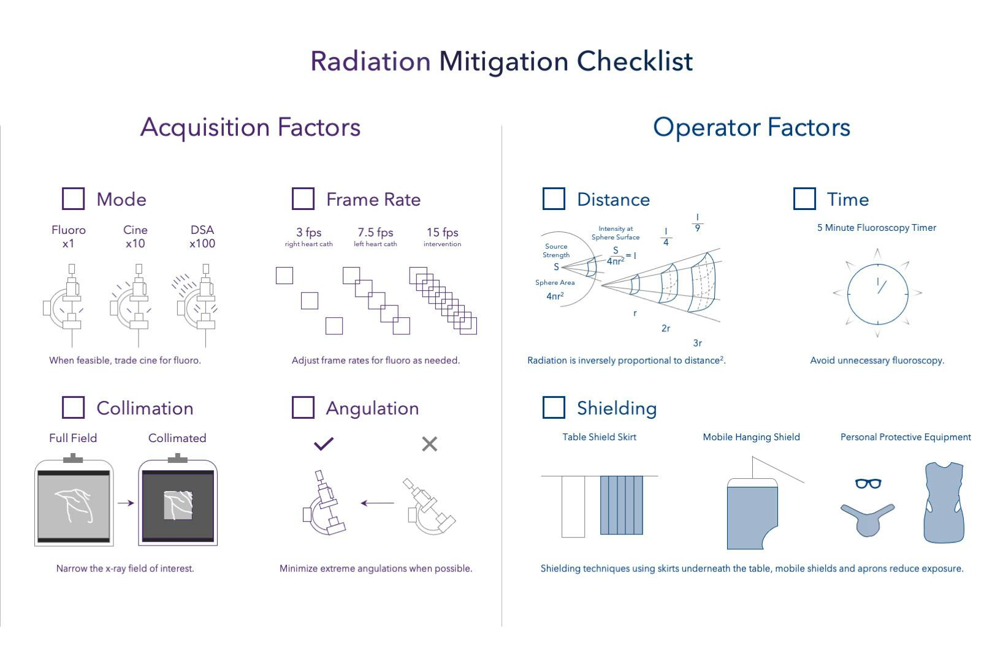
Occupational Hazards
Medranda & Gogo, Cardiac Interventions Today 2023

Slide 5
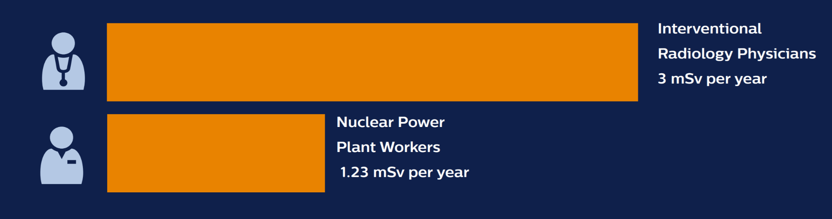
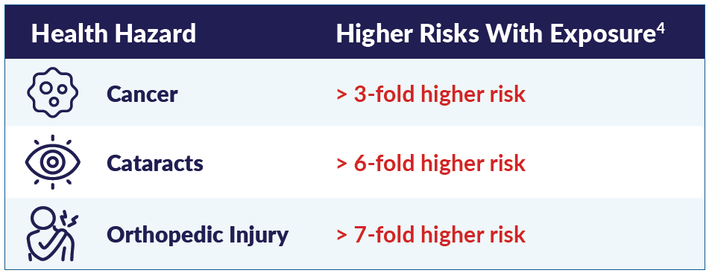
Interventional Teams are at Risk from Occupational Hazards
RADIATION
ORTHOPEDIC
Orthopedic Issues: 48%
Caused/Worsened by Work: 70%
Retired or Cut Back Work: 50%
International Atomic Energy Agency: Occup Med (Lond). 2010;60(6):464-9. Zakeri F, Hirobe T, Akbari Noghabi K. Biological effects of low-dose ionizing radiation exposure on interventional cardiologists.
Andreassi MG, Picano E, Ghelarducci B, et al. Occupational health risks in cardiac catheterization laboratory workers. Circ Cardiovasc Interv. 2016;9(4):e003273.
ACC Survey; Nagelhout CardioServe 2016;40. David Rizik, MD; SCAI 2024.

Slide 6
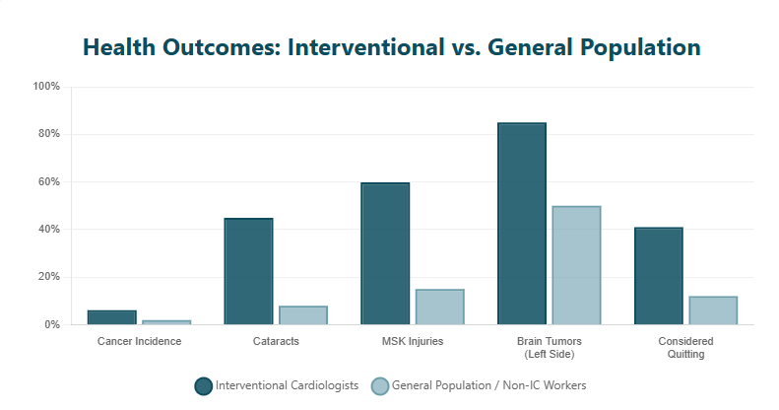
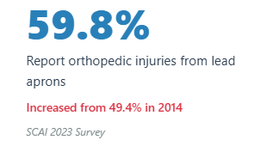
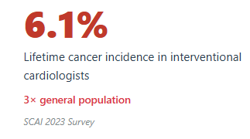
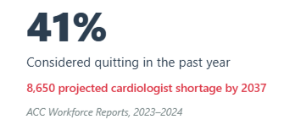
Risks for Healthcare Workers vs. the General Population
Source: https://orsif.org/toolkit

Slide 7
Orthopedic Standards for Healthcare Workers
OSHA does not have a specific enforceable standard dedicated to occupational orthopedic risks, but does outline guidelines through the General Duty Clause (Section 5(a)(1) of the OSH Act):
(a) Each employer --
(1) shall furnish to each of his employees employment and a place of employment which are free from recognized hazards that are causing or are likely to cause death or serious physical harm to his employees;
(2) shall comply with occupational safety and health standards promulgated under this Act.
(b) Each employee shall comply with occupational safety and health standards and all rules, regulations, and orders issued pursuant to this Act which are applicable to his own actions and conduct.
OSHA provides guidelines for the following industries, but notably not for interventional healthcare workers:
  Beverage Distribution
  Foundries
  Nursing Homes
  Shipyards
  Retail Grocery Stores
  Poultry Processing
  Meatpacking Plants
Source: https://www.osha.gov/ergonomics/

Slide 8
OSHA Radiation Standards for Healthcare Workers
OSHA’s standard has not been substantially revised since 1971 and does not reflect modern interventional practice or current scientific understanding of radiation risks.
US Interventional Healthcare worker guidelines are at least:
  50x those of the general public
  2x those of international radiation workers
Under OSHA's Ionizing Radiation standard (29 CFR 1910.1096), employers must:
  Ensure that occupational dose limits are not exceeded (1910.1096(b) and (c))
  Survey radiation hazards in order to comply with the standard (1910.1096(d)(1))
  Supply appropriate personal monitoring (e.g., dosimeters) (1910.1096(d)(2))
  Post caution signs, labels, and signals (1910.1096(e))
  Provide instruction to personnel and post-operating procedures (1910.1096(i))
Source: https://www.osha.gov/ionizing-radiation/standards

Slide 9
Radiation Standards for Healthcare Workers
US and International Dose Recommendations for Healthcare Workers:
However, in the US an employer may permit an individual in a restricted area to receive doses to the whole body greater than those permitted above, so long as: during any calendar quarter, the dose to the whole body shall not exceed 3 rem; and the dose to the whole body, when added to the accumulated occupational dose to the whole body, shall not exceed 5(N-18) rem, where “N” equals the individual's age in years at the individual's last birthday:
Anatomy | US Annualized (OSHA) | International Annualized (ICRP)
Whole Body | 5,000 mrem | 2,000 mrem
Eye Lens | 5,000 mrem | 2,000 mrem
Hands, forearms, feet and ankles | 75,000 mrem | 50,000 mrem
Pregnant Worker | N/A | 100 mrem
Total effective dose equivalent for members of the public | 100 mrem | 100 mrem
US Whole Body Limit for Healthcare Workers | 12,000 mrem/yr
US Whole Body Lifetime Occupational Accumulation Allowance (65-year-old Interventional Cardiologist) | 235,000 mrem
Source: https://www.osha.gov/ionizing-radiation/standards

Slide 10
Occupational Hazards—Orthopedic Injury
Protection against ionizing radiation is critically important to protect all team members
Current guidelines and best-practices requires all members of the CCL team wear lead aprons and thyroid shield
  Lead thickness of 0.5 mm should stop 95% of scatter radiation
  Protective integrity must be checked regularly
  Conventional lead aprons are now being replaced with newer aprons made of lighter materials that include aluminum, antimony, barium, bismuth, tungsten, tin, and titanium.
  Yet, these composite aprons may still pose significant cumulative orthopedic burden to the members of the CCL team…

Slide 11
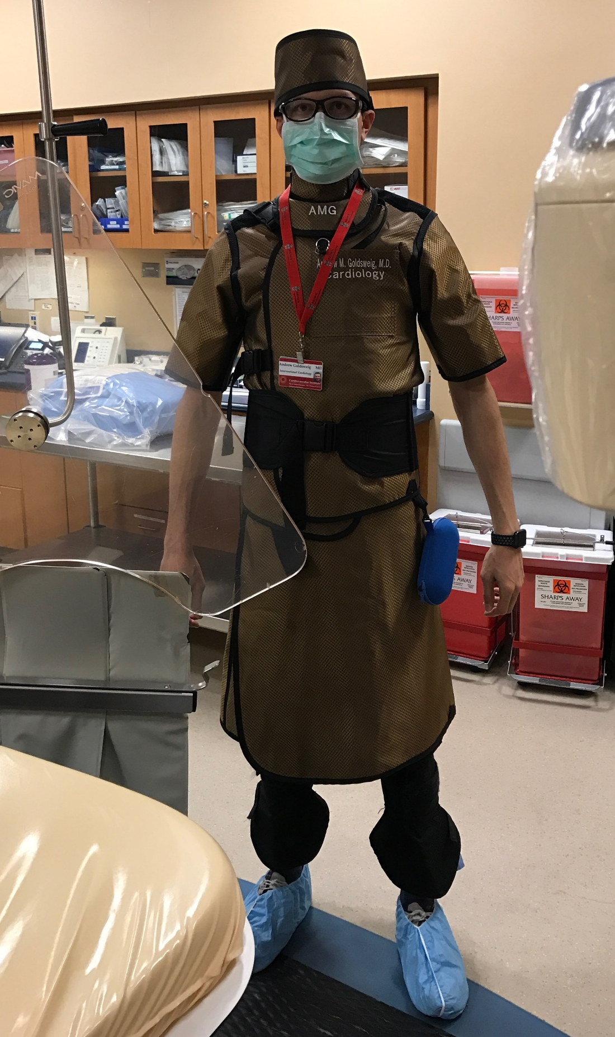
Occupational Hazards—Orthopedic Injury
Heavy “Lead” Garments
  Shielded hat
  Glasses
  Thyroid collar
  Sleeves (short or long)
  Vest and skirt
  Leg guards

Slide 12
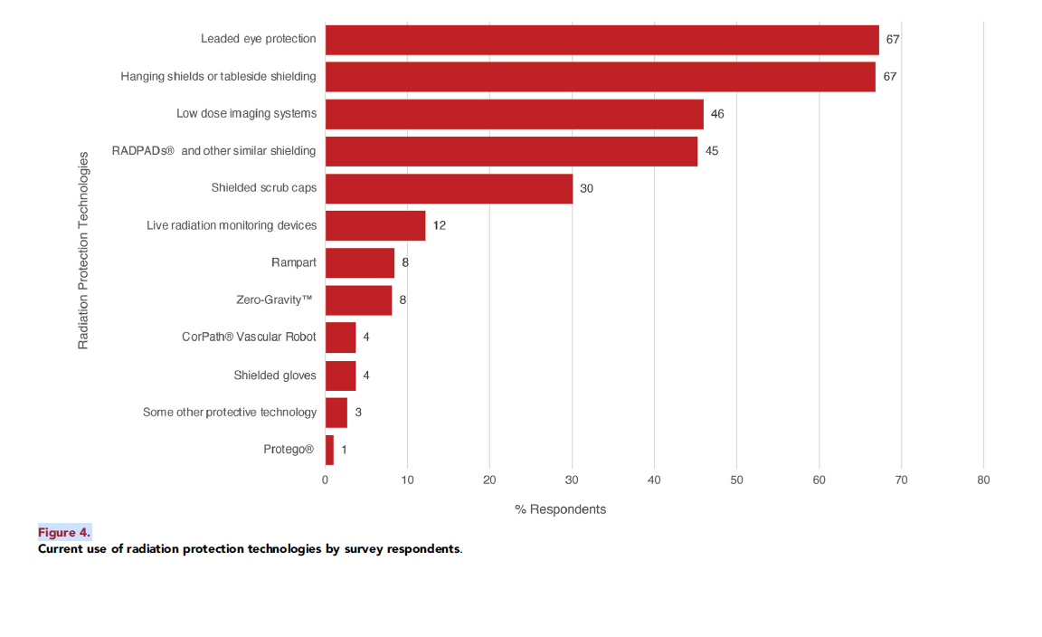
Additional Protection Is Seldom Used
Enhanced Radiation Protection Devices
Limited Access + Resource Intensive
PMID: 40308248

Slide 13
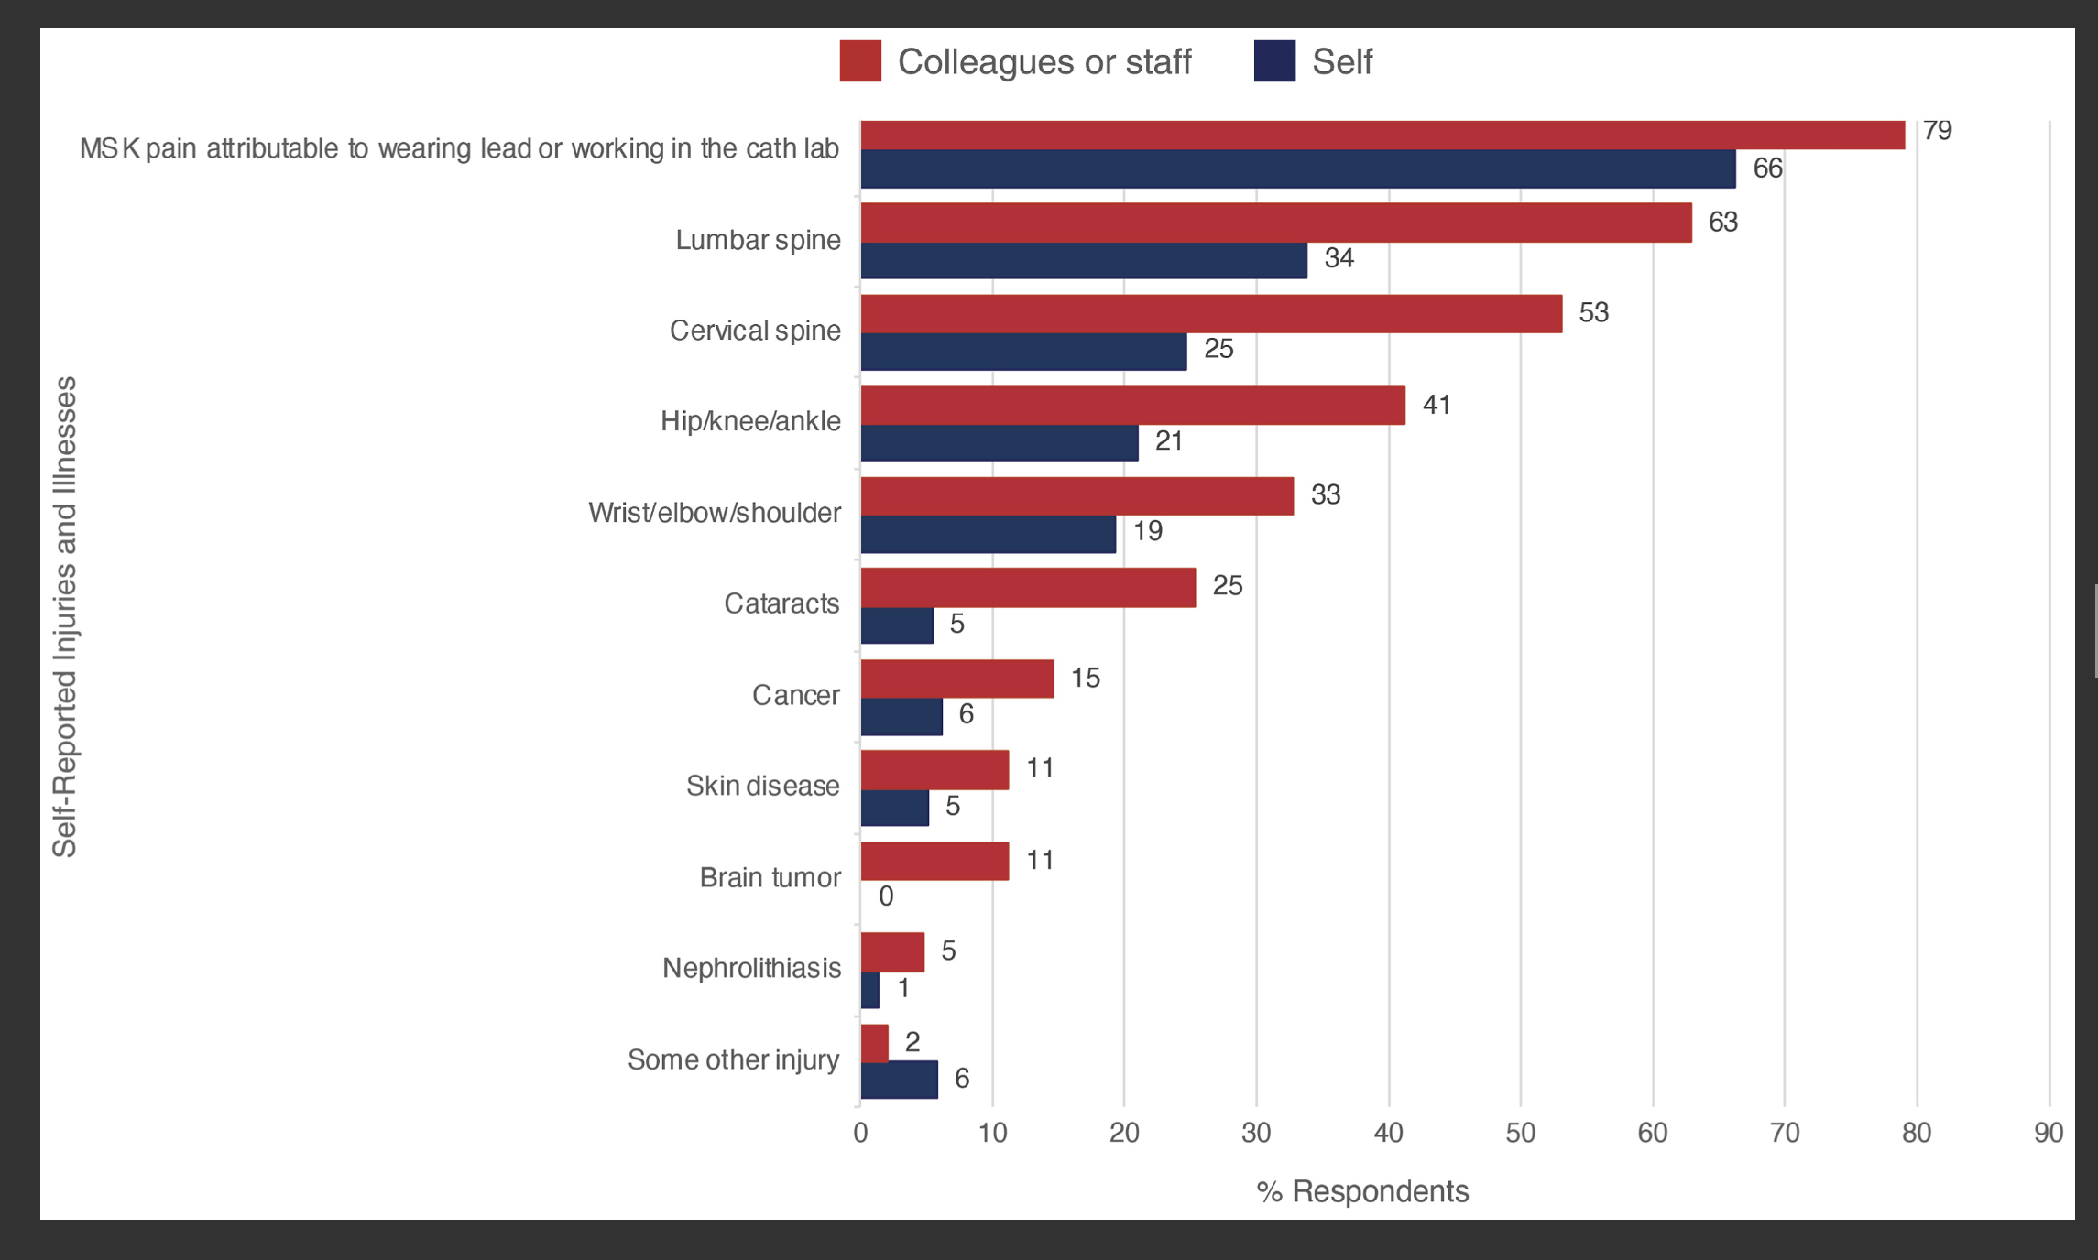
Occupational Hazards—Orthopedic Injury
Orthopedic injuries from wearing lead affect operators AND the staff nurses and technicians, who need to support multiple cases each day
The annual prevalence of work-related MSK disease amongst all nurses is 77.2% with up to 65.5% requiring a leave of absence
PMID: 40308248, 37124897

Slide 14
Occupational Hazards—Orthopedic Injury
The lumbar/cervical spine is most frequently affected.
A 15lb lead apron exerts about 300 psi of pressure in discs.
Lower back pain is prevalent in >50% of frequent “lead” apron users.
Neck pain attributable to ceiling mounted monitors requiring frequent neck manipulation.
2023 SCAI Survey:
  66% described musculoskeletal pain attributable to wearing RPG or working in the catheterization lab
  79% reported similar injury in colleagues or staff
Ergonomics of lab greatly influence musculoskeletal health.
Imagers are at particular risk, given the abnormal mechanics of holding a TEE probe.
PMID: 9024739, 9024739, 27993508, 38094529

Slide 15
Occupational Hazards—Ionizing Radiation
Interventional physician: highest exposure to radiation as primary operator.
Advanced cardiac imagers: present in structural and congenital interventional procedures and may be closest to the patient and image intensifier. Radiation exposure is often similar to or more than the most proximal procedural operator.
Technologists and nurses: see relatively less radiation due to their distance from the intensifier (via the inverse square rule). Primary operators should remain mindful when using fluoroscopy if staff approach the patient.
PMID: 40276545, 29544609, 38490315

Slide 16
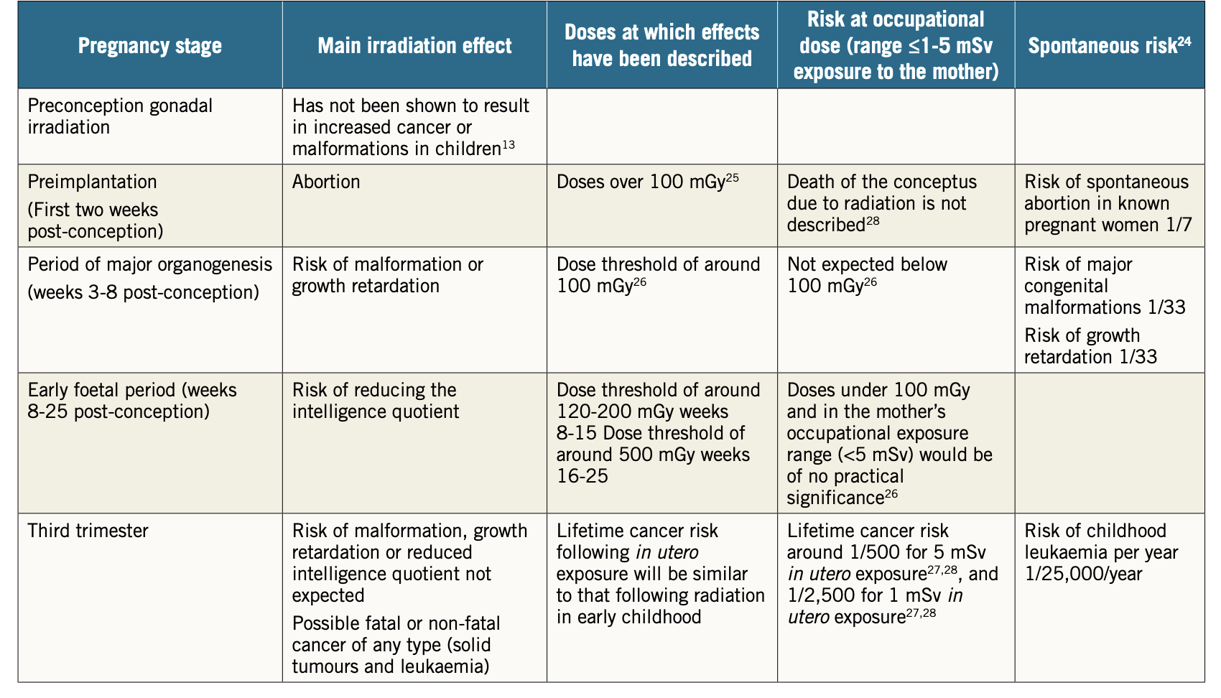
Occupational Hazards—Female Health
Fetal Effects
PMID: 29170633, 29170633, 29170633

Slide 17
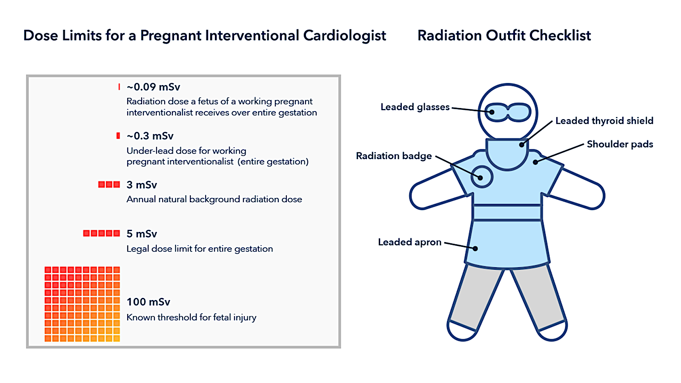
Occupational Hazards—Female Health
Deterministic Risk—Threshold Dependent
Tamirisa. Toll of Radiation and Lead on Physicians and CV Professionals: A Female Perspective​, SCAI Radiation Summit Presentation, May 2025.​

Slide 18
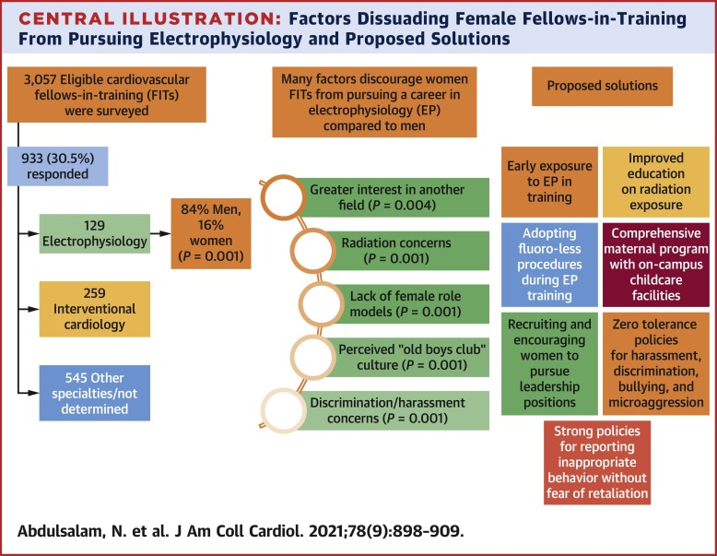
Occupational Hazards—Female Health
One of the Barriers
Females/males were equally concerned about radiation exposure for personal well-being.
However, females were more likely to be concerned about radiation exposure during childbearing.
Missed career opportunities and retention Loss-Talent Cliff
PMID: 34446162

Slide 19
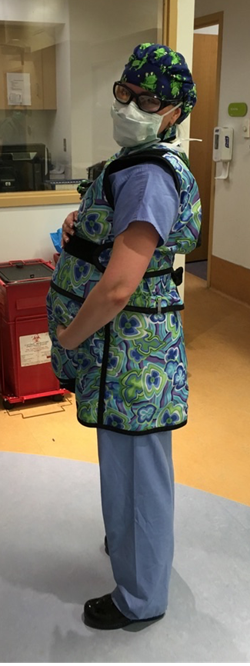
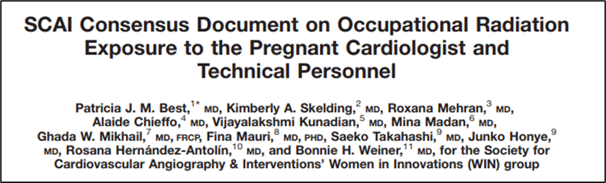
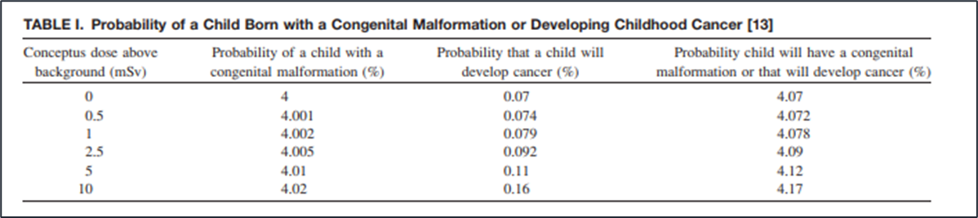
Occupational Hazards—Female Health
Pregnancy in the Cath Lab
“Current data do not suggest a significant increased risk to the fetus of pregnant women…”
PMID: 21061249

Slide 20
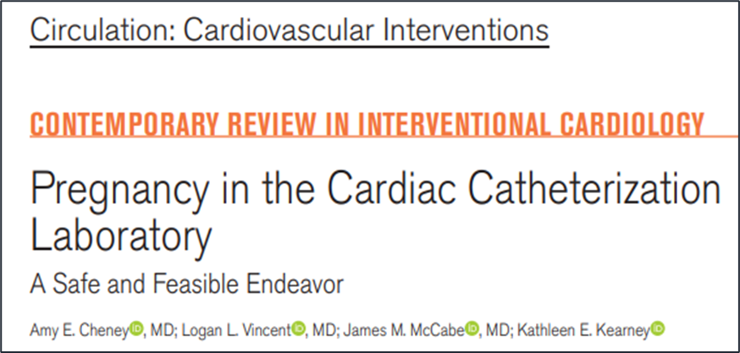
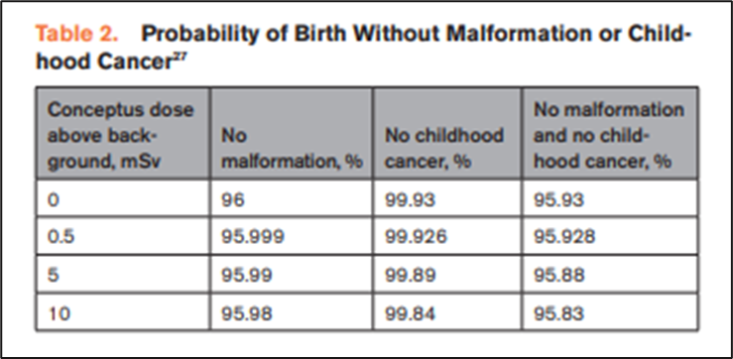
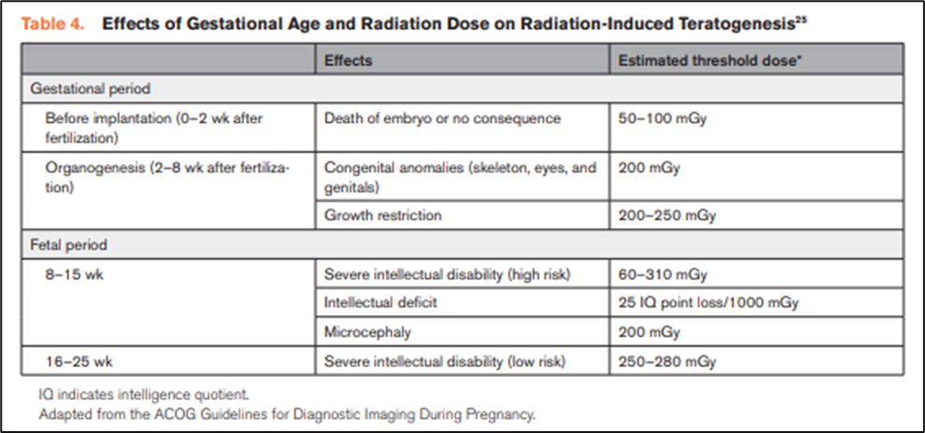
Occupational Hazards—Pregnancy in the CCL
First trimester = max fetal vulnerability
Later exposure = potential growth and intellectual deficits
Estimated threshold doses are higher than what typically received under lead.
PMID: 33877865

Slide 21
Best Practices to Reduce Radiation Exposure and Musculoskeletal Injuries

Slide 22
Managing Radiation Exposure
3 main principles of ALARA (As Low As Reasonably Achievable):
Time: Reducing frames per second (eg. 7.5 FPS) and time on fluoroscopy pedal can decrease operator scatter and patient radiation
Distance: Position the table away from X-ray source and toward the image-intensifier
Shielding: Use of personal protective equipment (lead aprons) and structural barriers

Slide 23
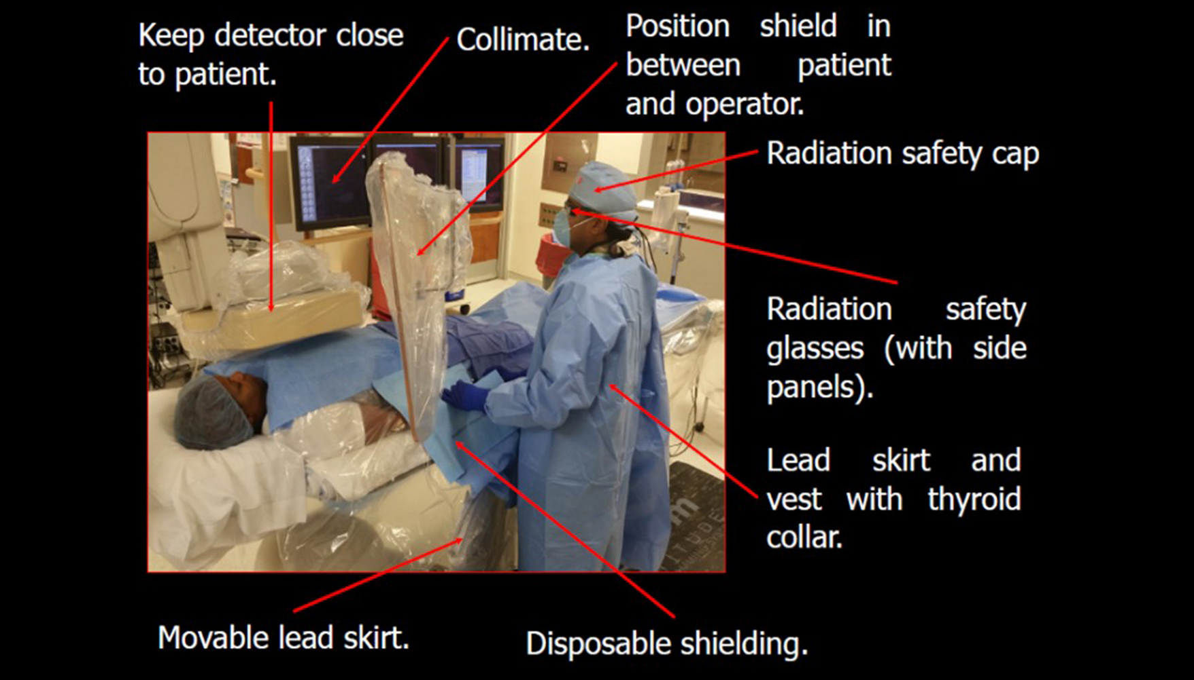
Fundamentals

Slide 24
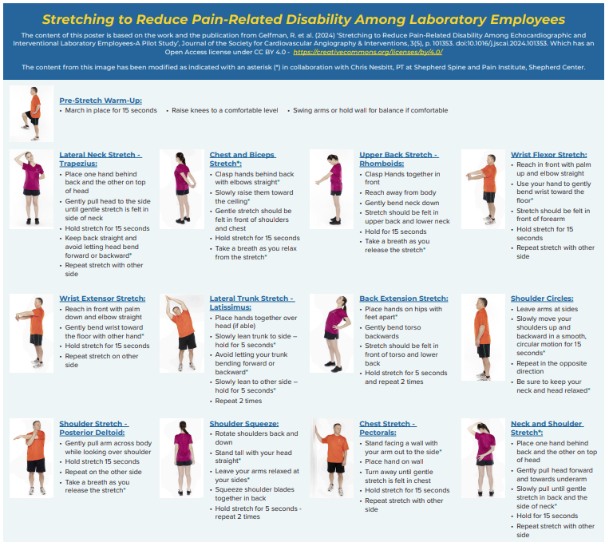
Exercises and Stretches
Notes:
https://www.jscai.org/article/S2772-9303(24)00139-X/pdf - relevant study in JSCAI

Slide 25
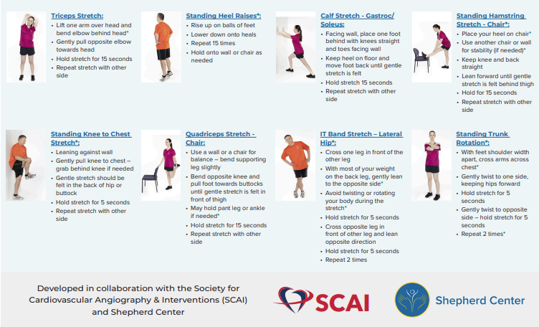
Exercises and Stretches (cont’d)

Slide 26
Ergonomics, Posture, and Position
Avoid standing on one foot
Keep monitors at eye level
Systematically avoid “stooping over” especially for extended periods
Use a thick rubber pad to stand on
Minimize equipment wait time—(pre-order what you might need in the room) the average peripheral case uses at least 5 and complex cases use up to over 20 pieces of equipment (wires, catheters for crossing, the Therapy delivery catheters). Even a 1-minute wait per-piece adds 20 minutes of standing with the lead to an already long case.

Slide 27
Interpreting Dosimetry Reports
Terms to Know
  DDE = Deep dose equivalent (1cm within the body-deeper tissues)
  SDE = Shallow dose equivalent (0.007 cm deep—skin level)
  LDE = Lens dose equivalent

Slide 28
How to Read Your Dosimetry Report
The inception date tells you how long the current dosimetry company has been keeping your records
“M” means minimal if received less than 1 mrem during recording period
You can call your dosimetry monitoring company e.g., Landauer, to obtain details
You will need your account number and subaccount number from your dosimetry report

Slide 29
How to Read Your Dosimetry Report: Control
Every facility has “Control” badges located away from radiation source (i.e., outside cath room)
Amount of dose received (mrem)—amount of dose calculated on control badge (mrem)
Measures background radiation exposure (all exposure) as control, so that the reported dose is only “occupational” dose
For practical purposes: Gy = Sv

Slide 30
Types of Radiation Reported
Pa = records X, Beta, and gamma radiation worn on collar, chest, or waist
Ja, Ta = neutron exposure
S = ring dosimeter (measures Beta radiation)
Fetal = worn by pregnant worker (but not necessary as fetal dose can still be calculated using other dosimeter)

Slide 31
What to Look For
Unit to measure radiation exposure, typically "millisieverts" (mSv)
Compare your reported dose to established reference levels for the specific procedure (take into account patient’s body habitus)
Constantly evaluate if all measures taken to minimize exposure for each fluoro or cine performed
Monitor personal radiation exposure trends over time and implement changes to minimize exposure

Slide 32
Interpreting Your Radiation Report
The primary unit used to measure radiation exposure in interventional cardiology is the "dose area product" (DAP), measured in Gray-cm² (Gy-cm²)
DAP indicates the total radiation dose delivered to the patient during a procedure and compare it to established benchmarks for the same procedure (considering body habitus, equipment type)
Older cath labs emit more radiation

Slide 33
What to Look For
Effective dose:
  Most relevant measure of radiation exposure, as it considers the sensitivity of different organs to radiation
Procedure-specific dose metrics:
  Different imaging modalities have their own specific dose metrics, such as CTDI (computed tomography dose index) for CT scans
Individual dose history:
  The report should show a cumulative dose for the reporting period, allowing for comparison to regulatory limits

Slide 34
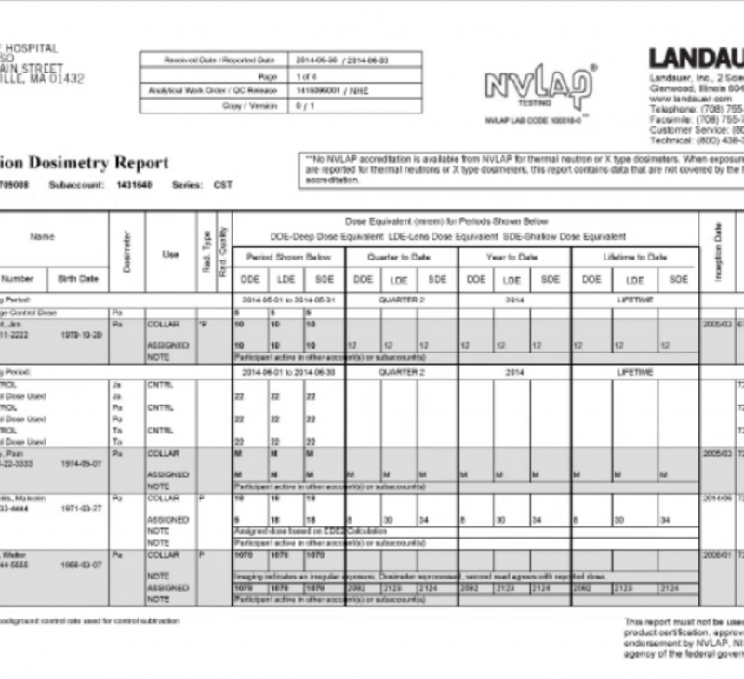
Typical Report (Landauer)

Slide 35
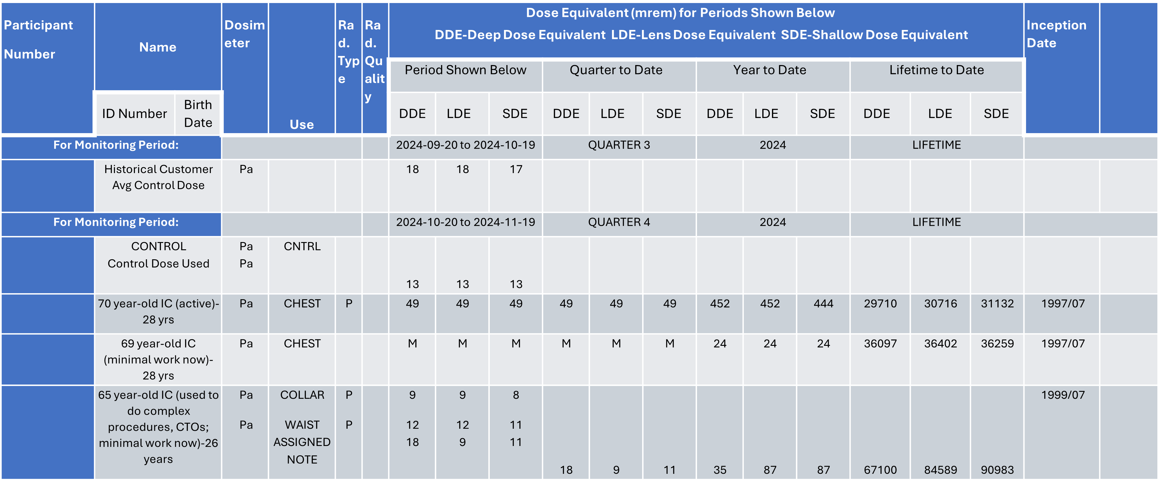
Exposure Example

Slide 36
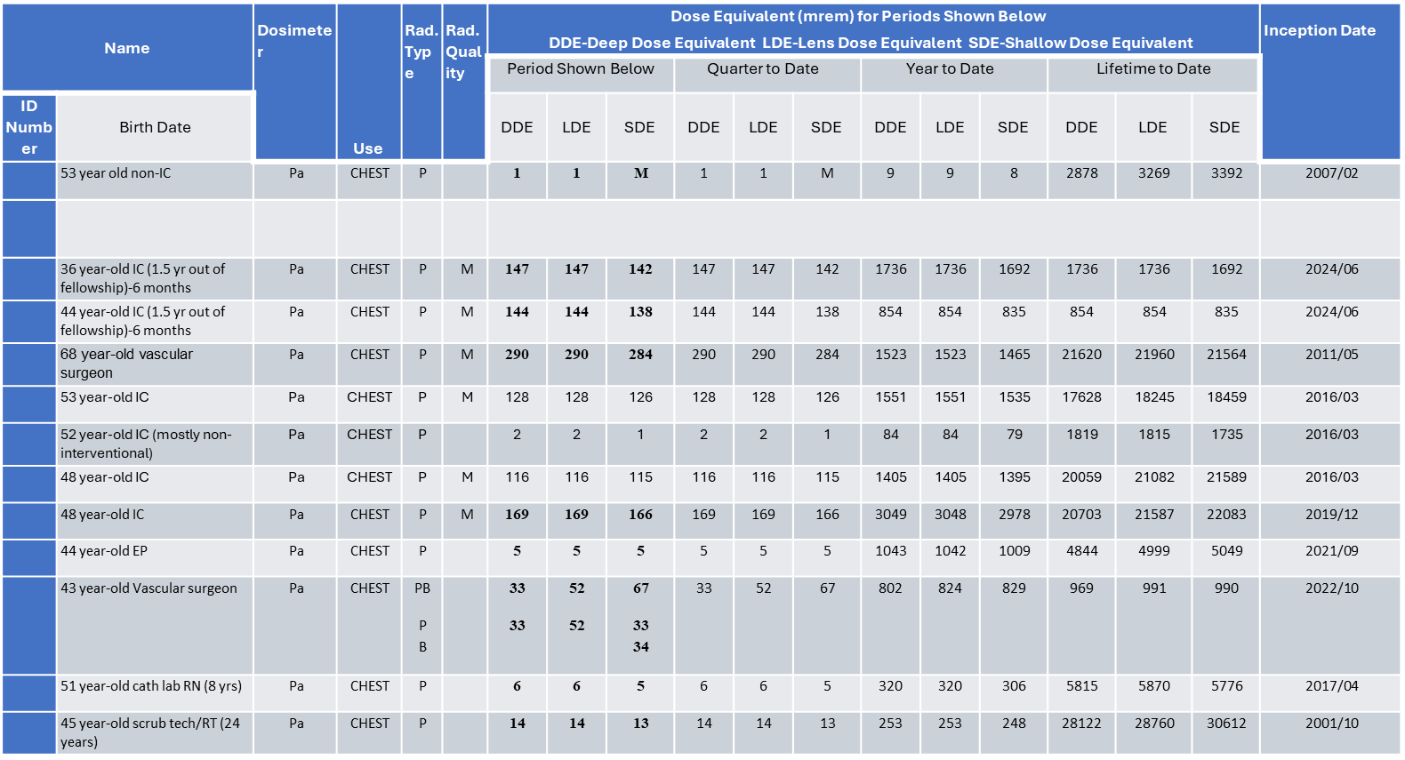
Exposure Examples

Slide 37
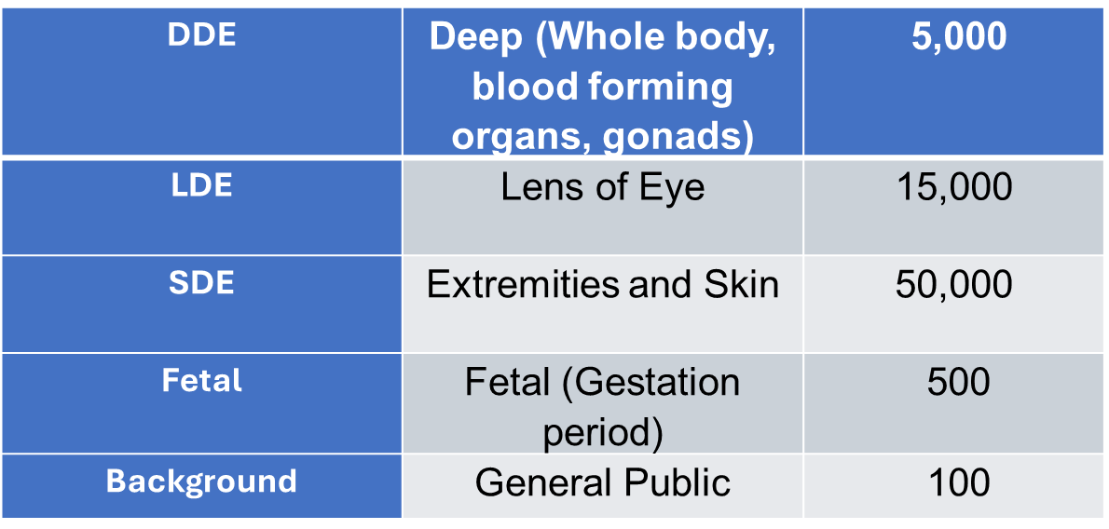
Annual Radiation Exposure Limits (mrem/year)

Slide 38
Investigational Levels
Body part Investigation Levels (mrem/quarter)
Dose Equivalent ALARA I (10%) ALARA II (30%)
1. Deep (whole body, blood 125 375
forming organs, gonads)
2. Lens of the eye 375 1125
3. Skin/Shallow (whole body) 1250 3750
4. Extremity/Shallow 1250 3750

Slide 39
Quarterly Investigational Levels
ALARA Level I (10% of Quarterly Dose): The dose received is reviewed by the radiation safety officer (RSO), or a designee (ARSO). No further action taken when the dose is less than the level for ALARA I, unless the RSO has reason to question the exposure.
ALARA Level II (30% of Quarterly Dose): The RSO/ARSO will investigate all personnel with exposure equal to or greater than Investigational Level II. A report of the investigation and recommendations will be presented to the Radiation Safety Committee (RSC).
Annual Regulatory Limit: The RSO will immediately investigate any personnel with exposure equal to or exceeding the annual regulatory limit. Immediate corrective action will be taken to prevent additional exposure, and report to the appropriate regulatory agency.

Slide 40
Published Studies on Simple Radiation Reduction Protocols
Cleveland Clinic:
  Reduced average dose from 896 to 357 mGy, (PCI 1994 mGy to 1265 mGy)
  Using 7.5 fps as default vs 10 fps
  Low dose acquisition mode
  Recalibration of detector dose
  Training on collimation, less extreme angulation, and reduced source-detector distance
Cairo:
  Radiation exposure was reduced for operators from 4.29 mSv to 3.48 mSv just with education about radiation and using shielding
PMID: 36073017, 38334916

Slide 41
Acknowledgements
Thank you to Nicolae Achim and Jeremy Magnum for reviewing the content of these slides

